Slide 1
Computational Linguistics
(aka Natural Language Processing)
Bill MacCartney
SymSys 100
Stanford University
26 May 2011
(some slides adapted from Chris Manning)
Notes:
I’m Bill MacCartney, I’m a research scientist at Google, and two years ago I completed a Ph.D. in Computer Science here at Stanford.
Today I’m going to be talking about my field of study, which is Computational Linguistics, aka Natural Language Processing.
I’m going to try to give you high-level overview of the field.
I’ll talk about what it is, why it matters, and where it is today.
I’ll give you a little bit of history, and I’ll briefly describe some of the most important subfields and applications.
And if there’s time, I’ll go a little bit deeper on one subfield in particular, which is machine translation,
and I’ll try to give you just a taste of how machine translation is done.
Now, how many of you are familiar with xkcd? […] Well, if you’re not already reading xkcd, you really should, because:
(*) you’re at Stanford, and (*) you’re in SymSys, so therefore (*) you’re a nerd. And xkcd is really required reading for nerds.
And it turns out that the author of xkcd, Randall Munroe, is very interested in computational linguistics. In fact… [>]

Slide 2
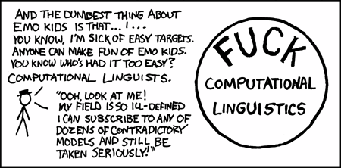
xkcd snarkiness
OK, Randall, it’s funny … but wrong!
cartoon from xkcd.com
Notes:
… he’s pretty negative about it.
Now I love xkcd, and I love Randall Munroe, and I even love this particular cartoon. But I really think he got this one wrong.
I’m going to try to convince you today that, contrary to Randall’s claim,
computation linguistics is a quite coherent field of study with a lot to offer the world. [>]

Slide 3
A word on terminology
If you call it …
Computational Linguistics (CL)
  … you’re a linguist!
  … you use computers to study language
Natural Language Processing (NLP)
  … you’re a computer scientist!
  … you work on applications involving language
But really, they’re pretty much synonymous
Notes:
Now before we jump in, a word on terminology.
It’s sort of a funny historical accident that there are really two different names for this field.
People coming from linguistics tend to call it computational linguistics,
and people coming from computer science tend to call it natural language processing, or NLP.
But they’re really the same thing, it’s really one field.
I come from the computer science side, so you’ll usually hear me calling it NLP.
Actually, the fact that it has two names reflects the interdisciplinary nature of the field. [>]

Slide 4
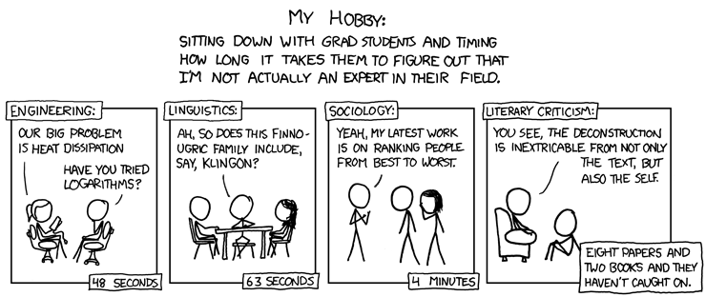
Let’s get situated!
Today, we are in this interstice
cartoon from xkcd.com
Notes:
So to help us get situated, here’s another xkcd cartoon.
Computational linguistics – or NLP – really lies at the juncture between computer science and linguistics.
It’s about getting computers to do useful things with human language.
And if you haven’t had time to read the cartoon, don’t worry, I’ll put the slides online. [>]

Slide 5

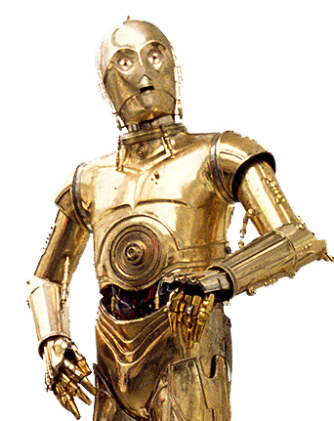

NLP: The Vision
I’m sorry, Dave. I can’t do that.
Oh, dear!
That is correct, captain.
Notes:
Now if you’re in SymSys, you’ve probably been excited about AI since you were about … eight years old. I know I have.
For years, we’ve all been dreaming about having computers that can talk to us.
The ability to use language is an essential ingredient of the AI vision,
and the quest to endow computers with this ability has been the ultimate driver of NLP research for more than 50 years.
This dream is ultimately the reason why I’m standing here today. [>]

Slide 6

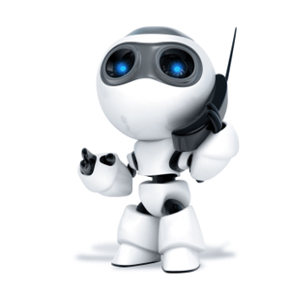
Language: the ultimate UI
Where is A Bug’s Life playing in Mountain View?
A Bug’s Life is playing at the Century 16 Theater.
When is it playing there?
It’s playing at 2pm, 5pm, and 8pm.
OK. I’d like 1 adult and 2 children for the first show.
How much would that cost?
But we need domain knowledge, discourse knowledge, world knowledge
(Not to mention linguistic knowledge!)
Notes:
After all, language is really the ultimate user interface – well, maybe not for all applications, maybe not for Photoshop.
But wouldn’t it be incredibly useful if you could have an interaction like this?
But this is well beyond what we can do today. Take a moment to consider what makes this hard.
Let me focus just on the problem of reference resolution – figuring out what various expressions refer to.
We need to recognize that “A Bug’s Life” refers to a movie, and “Mountain View” refers to a town.
We need to figure out that “it” refers to “A Bug’s Life”, “there” refers to “the Century 16 Theater”, and “that” refers to the tickets.
And we need to understand that people don’t generally buy adults and children, and therefore that the user is referring to buying adult and child tickets.
We also need to figure out that “the first show” refers to 2pm, because 2pm is earlier than 5pm and 8pm.
And that’s just for reference resolution. So this is really quite challenging. [>]

Slide 7
NLP: Goals of the field
From the lofty …
  full-on natural language understanding
  participation in spoken dialogues
  open-domain question answering
  real-time bi-directional translation
… to the mundane
  identifying spam
  categorizing news stories (& other docs)
  finding & comparing product information on the web
  assessing sentiment toward products, brands, stocks, …
Predominant in recent years
Notes:
In fact, the goals of NLP cover a huge spectrum, from the grandiose to the pedestrian.
One one hand, we’d love to support spoken dialogs like the one on the previous slide.
And we’d like to be able to answer natural language questions on any topic – you probably saw IBM’s Watson in the news a couple of months ago.
And we’d like to do real-time oral translation. This is actually something Google is working towards today – a smartphone app that would let you sit down with someone who doesn’t speak your language, put your phone on the table, and have a conversation, and the phone would translate in real time, just like a human translator.
But in recent years most of the action – and most of the successes – have been in more down-to-earth applications, like shopping engines or sentiment analysis. [>]

Slide 8














NLP in the commercial world
Powerset
Notes:
In fact NLP is an extremely hot area in the commercial world right now, and people with NLP skills are in high demand.
There’s a widespread perception that NLP technologies are finally reaching maturity in many areas, and are poised to make a huge impact.
So you see Apple doing information extraction on emails,
you see Google using word sense disambiguation and synonym generation in search,
you see Microsoft doing grammar checking,
and you see more and more startups trying do semantic search and sentiment analysis.
Some of these efforts are more successful than others, but there’s no doubt that it’s an exciting time to be doing NLP. [>]

Slide 9
Current motivations for NLP
What’s driving NLP? Three trends:
  The explosion of machine-readable natural language text
    Exabytes (10¹⁸ bytes) of text, doubling every year or two
    Web pages, emails, IMs, SMSs, tweets, docs, PDFs, …
    Opportunity — and increasing necessity — to extract meaning
  Mediation of human interactions by computers
    Opportunity for the computer in the loop to do much more
  Growing role of language in human-computer interaction
Notes:
There are really three trends driving this surge of interest in NLP.
The first is the explosion of natural language text available in machine-readable form.
Twenty years ago, there was very little machine-readable text available.
Today, there are terabytes and petabytes and exabytes of text available – literally exabytes – that’s a billion gigabytes.
That’s web pages and emails and IMs and tweets and academic papers and court documents and medical records and so on and so forth.
And that means a huge opportunity – and a growing necessity – to extract some kind of meaning from all this text.
The second trend is that more and more, we’re seeing computers using NLP to add value to human interactions.
I’ll give an example from my own work. After finishing my Ph.D., I joined a startup called Aardvark.
Aardvark is about social question answering. Aardvark is basically a bot that sits on your buddy list in your IM client, and when you have a question about something, you IM your question to Aardvark, and Aardvark figures out the right people in your social network to relay the question to, by doing some semantic analysis of the content of the question.
So you get answers from humans, but the machine figures out who to ask.
So this is a really useful application that relies crucially on NLP technology.
The last trend is the increasing importance of natural language interactions between humans and computers. [>]

Slide 10
Further motivation for CL
One reason for studying language — and for me personally the most compelling reason — is that it is tempting to regard language, in the traditional phrase, as a “mirror of mind”. Chomsky, 1975
For the same reason, computational linguistics is a compelling way to study psycholinguistics and language acquisition.
Sometimes, the best way to understand something is to build a model of it.
What I cannot create, I do not understand. Feynman, 1988
Notes:
From the linguistics side, there’s another motivation, which is that computational linguistics may be an avenue to understanding how the mind learns and processes language.
The idea is, if you want to understand how the mind deals with, say, syntactic attachment ambiguity,
it may be helpful to build a computer model that solves the same problem.
Even if the mind doesn’t work exactly like the model, building the model will help you understand where the difficulties lie.
When the great physicist Richard Feynman died, these words were on his blackboard: “What I cannot create, I do not understand”.
Sometimes, the best way to understand something is to build a model of it. [>]

Slide 11
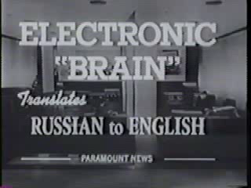
Early history: 50s and 60s
Foundational work on automata, formal languages, probabilitistic modeling, and information theory
First speech systems (Davis et al., Bell Labs)
MT heavily funded by military — huge overconfidence
But using machines dumber than a pocket calculator
Little understanding of syntax, semantics, pragmatics
ALPAC report (1966): crap, this is really hard!
Notes:
So let me now spend a few minutes on the history of the field.
People have been working on language applications since the very beginning of computer science, more than 50 years ago.
Early on, there was a particular emphasis on machine translation, one of the hardest problems in NLP.
This was in the depths of the Cold War, and the military was naturally very interested in translating Russian to English.
Even though they were working on extremely limited hardware, early researchers were confident that they’d have the problem licked within a few years.
I have an amusing clip that reflects this …
But several years passed, and the problem still wasn’t solved, and finally in the mid-60s the government commissioned this report, the ALPAC report,
which essentially concluded, crap, this is much harder than we thought. And that basically killed further work in MT for many years. [>]

Slide 12

Refocusing: 70s and 80s
Foundational work on speech recognition: stochastic modeling, hidden Markov models, the “noisy channel”
Ideas from this work would later revolutionize NLP!
Logic programming, rules-driven AI, deterministic algorithms for syntactic parsing (e.g., LFG)
Increasing interest in natural language understanding: SHRDLU, LUNAR, CHAT-80
But symbolic AI hit the wall: “AI winter”
Notes:
In the 70s, the field regrouped and refocused.
There were teams at Bell Labs and at IBM who were doing early work in speech recognition.
Actually, they were in a quite separate research community – they were electrical engineers, and they had little communication with the main stream of NLP research.
But their ideas – using statistical modeling and probability distributions -- would later turn out to revolutionize the field.
People in the main stream of NLP research saw themselves as part of the field of AI, and at the time that meant symbolic AI.
So they were using hand-built knowledge resources and rule-driven algorithms.
And there was an increasing interest in natural language understanding applications.
SHRDLU was a program that was the dissertation work of Terry Winograd, who is a professor here – I’ll show you a clip about that.
LUNAR was a program that could answer natural language questions about moon rocks, and CHAT-80 could answer questions about geography.
(In those days, if you wrote a program, you had to come up with a cool name in ALL CAPS – CamelCasing didn’t become cool until the 90s.) [roll the clip]
But by the late 80s, it was becoming clear that symbolic AI had run out of steam, and something new was needed.

Slide 13
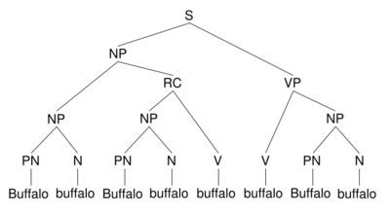
The statistical revolution: 90s
Influx of new ideas from EE & ASR: probabilistic modeling, corpus statistics, supervised learning, empirical evaluation
New sources of data: explosion of machine-readable text; human-annotated training data (e.g., the Penn Treebank)
Availability of much more powerful machines
Lowered expectations: forget full semantic understanding, let’s do text cat, part-of-speech tagging, NER, and parsing!
Notes:
In the 90s, everything changed. NLP researchers finally began to really pay attention to this new current of ideas from the EE and speech recognition community.
They began to use to probabilistic modeling and corpus statistics. They began to build classifiers on supervised training data.
This coincided with the explosion in machine-readable text that I mentioned earlier,
and also with the creation of large sets of human-annotated training data, such as the Penn Treebank.
The Penn Treebank consists of 50,000 sentences of Wall St. Journal text,
each labeled with a syntactic parse tree laboriously constructed by low-paid grad students at UPenn.
And it enabled the development of highly accurate statistical parsers, and made parsing a major focus of NLP research in the 90s.
And this reflected a shift in the goals of the field, away from full-on natural language understanding, which now seemed too hard,
and towards lower-level, more achievable tasks like text categorization, POS tagging, and named entity recognition. [>]

Slide 14
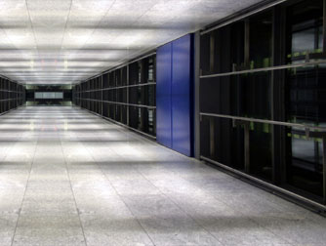
The rise of the machines: 00s
Consolidation of the gains of the statistical revolution
More sophisticated statistical modeling and machine learning algorithms: MaxEnt, SVMs, Bayes Nets, LDA, etc.
Big big data: 100x growth of web, massive server farms
Focus shifting from supervised to unsupervised learning
Revived interest in higher-level semantic applications
Notes:
In this last decade, these trends have continued and consolidated.
Statistical modeling has become absolutely central to NLP,
and NLP researchers have become very sophisticated in using machine learning algorithms like support vector machines and latent Dirichlet allocation.
The quantity of machine-readable text has continued to grow exponentially,
and massive server farms have enabled us to learn from this ocean of data – this has been critical for Google’s work in machine translation.
What’s new in the just the last couple of years is:
an increasing focus on unsupervised learning, which doesn’t require expensive human-annotated training data,
and a revived interest in higher-level semantic applications, like question answering, which were neglected in the 90s as too difficult. [>]

Slide 15



Subfields and tasks
mostly solved
making good progress
still really hard
Spam detection
Sentiment analysis
Semantic search
✓
OK, let’s meet by the big …
The pho was authentic and yummy.
people protesting globalization
✗
Search
D1ck too small? Buy V1AGRA …
Waiter ignored us for 20 minutes.
…demonstrators stormed IMF offices…
Text categorization
Coreference resolution
Question answering (QA)
Phillies shut down Rangers 2-0
SPORTS
Q. What currency is used in China?
Jobless rate hits two-year low
BUSINESS
Obama told Mubarak he shouldn’t run again.
A. The yuan
Part-of-speech (POS) tagging
Word sense disambiguation
(WSD)
Textual inference & paraphrase
ADJ ADJ NOUN VERB ADV
T. Thirteen soldiers lost their lives …
Colorless green ideas sleep furiously.
I need new batteries for my mouse.
H. Several troops were killed in the …
YES
Named entity recognition (NER)
Syntactic parsing
Summarization
PERSON ORG LOC
Sheen continues rant against …
Sheen continues rant against …
Sheen is nuts
Sheen continues rant against …
Obama met with UAW leaders in Detroit …
I can see Russia from my house!
Information extraction (IE)
Machine translation (MT)
Discourse & dialog
You’re invited to our bunga bunga party, Friday May 27 at 8:30pm in Cordura Hall
Party
May 27
add
Our specialty is panda fried rice.
Where is Thor playing in SF?
我们的专长是熊猫炒饭
Metreon at 4:30 and 7:30
Notes:
Like every other discipline nowadays, NLP is divided into specialties and subspecialties.
On this slide I want to give you a quick survey of some of the most notable subfields and tasks around which people organize their work.
For each area, I’ll try to tell you briefly what it is and why it matters.
I won’t say too much about how we solve it, but I will try to give an indication of how well we’re doing.
In fact, I’ve grouped the problems roughly into problems which are mostly solved, problems where we’re making good progress, and problems which are still really hard.
But you should take that categorization with a huge grain of salt – there are still big challenges over here, and there are already big successes over here.
…
Spam detection: 90% of emails sent are spam, but you rarely see them, so it works pretty well.
Text categorization takes many forms, but one is assigning news stories to clusters like Sports and Business.
POS tagging doesn’t matter directly to end users, but it’s a building-block technology that facilitates other tasks like sentiment analysis and parsing. 97% accuracy.
NER means identifying and classifying expressions denoting entities, such as people, places, and organizations. Again, a building block.
IE means extracting structured data from unstructured text. The example here is extracting information about calendar events; another is extracting product information for a shopping application.
Sentiment analysis has gotten a lot of attention in the commercial world, with the rise of social media; it’s about identifying positive or negative sentiment, either broadly toward products or brands, or narrowly towards specific features of a product. Very important for helping companies understand how they are perceived by consumers.
Coreference resolution includes not only identifying the antecedents of pronouns, but also other ways of referring to the same entity, like “President Obama” and “the President” and “Obama”.
WSD matters in many applications because words have far more senses than we are ordinarily aware of, and if you’re searching for web pages about mice, you might not want to see pages about rodents.
Syntactic parsing means inferring the hidden syntactic structure of sentences. A huge focus over the last 15 years. 90% accuracy on WSJ text. Important for understanding predicate-argument structure: who did what to whom? Also important for translation.
Machine translation: highly compelling end-user application. Major focus in 1950s, and again in 2000s. For some language pairs, we can do it pretty well; others are still really hard.
Semantic search. Retrieve pages if they’re talking about the same ideas, even if they don’t use the same keywords. Creeping into Google etc., but still really hard.
QA. Obvious utility. Vision of the answer machine. Can work well in restricted domains, but still tough in open domain. IBM’s Watson is a significant step forward.
Textual inference was the focus of my dissertation work – it means determining whether one natural language sentence follows from another. It’s connected with the ability to recognize semantic equivalence at sentence level. Lots of attention over last five years, but still really tough.
Summarization. Obvious end-user utility. Single-document and multi-document variations. Still really, really hard.
Discourse & dialog. Very loosely defined, can takes lots of forms. Very hard.

Slide 16
Why is NLP hard?
Natural language is:
  highly ambiguous at all levels
  complex, with recursive structures and coreference
  subtle, exploiting context to convey meaning
  fuzzy and vague
  involves reasoning about the world
  part of a social system: persuading, insulting, amusing, …
(Nevertheless, simple features often do half the job!)
Notes:
One thing I hope is coming through is that many of the things we’d like to do in NLP are really, really hard.
Why is that? Well, human language is just really complex.
You have tremendous variability of expression. You have complex, recursive structures.
Ambiguity is pervasive. Meaning is highly context-dependent, and is often fuzzy or vague.
And so on – I’ll bring this out more in the following slides.
On the other hand, The Major Lesson of the statistical revolution is that you can often get surprisingly far with very simple features.
Take, for example, sentiment analysis – you might think that understanding how people feel, emotionally, about a product would require
incredibly sophisticated natural language understanding, and theories of mind, and so on.
But in fact, you can often get pretty far just by counting occurrences of words like “quick” or “valuable” or “frustrating”.
But those simple features only carry you so far, and huge challenges remain, so let me try to bring some of those out. [>]

Slide 17





Meanings and expressions
soda
soft drink
pop
beverage
Coke
Notes:
One big obstacle is that the relation between meanings and expressions is not one-to-one. Far from it.
First, one meaning can be expressed in many different ways – so this thing can be described as “soda”, or a “soft drink”, or “pop”.
And conversely, one expression can have many different meanings – so “pop” can refer to the Biebster, or your Dad, or even Pop Art. [>]

Slide 18
One meaning, many expressions
To build a shopping search engine, you need to extract product information from vendors’ websites:
Image Capture Device: 1.68 million pixel 1/2-inch CCD sensor
Image Capture Device Total Pixels Approx. 3.34 million Effective Pixels Approx. 3.24 million
Image sensor Total Pixels: Approx. 2.11 million-pixel
Imaging sensor Total Pixels: Approx. 2.11 million 1,688 (H) x 1,248 (V)
CCD Total Pixels: Approx. 3,340,000 (2,140[H] x 1,560 [V] )
  Effective Pixels: Approx. 3,240,000 (2,088 [H] x 1,550 [V] )
  Recording Pixels: Approx. 3,145,000 (2,048 [H] x 1,536 [V] )
These all came from the same vendor’s website!
Notes:
So the first phenomenon is known as “variability of linguistic expression”, and it’s pervasive problem in NLP.
For example, if you want to build a product search engine, like shopping.google.com, you need to extract and aggregate product information from many different vendors’ websites.
And in order to facilitate product comparison, you want to normalize the representation of a product’s features.
If someone is shopping for a digital camera, one of the main things they care about it is how many megapixels the camera has.
But there are many, many different ways to express this in natural language.
So this variability of linguistic expression is a huge challenge for information extraction. [>]

Slide 19
One meaning, many expressions
Or consider a semantic search application:
Russia increasing price of gas for Georgia
Search
Russia hits Georgia with huge rise in its gas bill
Russia plans to double Georgian gas price
Russia gas monopoly to double price of gas
Gazprom confirms two-fold increase in gas price for Georgia
Russia doubles gas bill to “punish” neighbour Georgia
Gazprom doubles Georgia's gas bill
Notes:
As another example, consider semantic search.
Suppose you’re looking for news stories about Russia increasing the price of gas for Georgia.
Well, there are many different ways to express this idea in natural language.
So if you want to retrieve all these stories as relevant, you need to recognize that these are all roughly – even if not exactly -- semantically equivalent.
This is hard! [>]

Slide 20
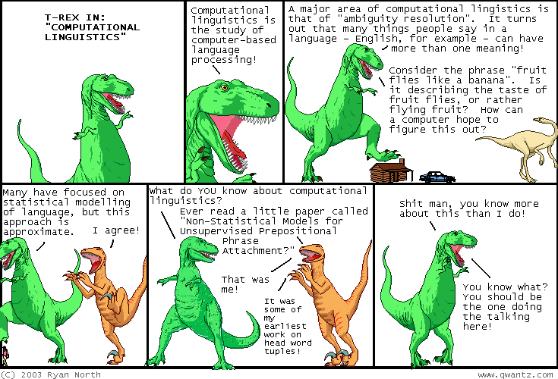
One expression, many meanings
cartoon from qwantz.com
Notes:
The converse problem is that one expression can have many meanings.
In this cartoon, T-Rex highlights the problem of AMBIGUITY RESOLUTION.
And he invokes a well-known example, “Fruit flies like a banana”.
Actually the full quotation is, “Time flies like an arrow; fruit flies like a banana.” This has been (dubiously!) attributed to Groucho Marx.
But let’s focus just on “Fruit flies like a banana”. What are the possible interpretations? [solicit answers]
What makes this ambiguous?
[>]

Slide 21


Syntactic & semantic ambiguity
syntactic ambiguity
S
S
VP
VP
semantic ambiguity
PP
NP NP
NP NP
Fruit flies like a banana
Fruit flies like a banana
photos from worth1000.com
Notes:
So we have two possible readings, represented here pictorially. And we have two different kinds of ambiguity.
First, there is semantic ambiguity.
“Flies” could be a noun, meaning insects, or it could be a verb, meaning travel by air.
And “like” could be a verb, meaning love, or it could be a preposition, meaning similar to.
[“like” is a remarkable word: it can be used as a noun, verb, adverb, adjective, preposition, particle, conjunction, or interjection.]
And then we also have a syntactic ambiguity.
It could be that “fruit flies” is the subject, and “like a banana” is the predicate.
Or it could be that “fruit” is the subject, and “flies like a banana” is the predicate.
These kind of ambiguities show up all over the place, and as humans, we’re so good at resolving them that usually we don’t even notice them consciously.
But sometimes, unintentional ambiguities produce a quite comic effect. [>]

Slide 22
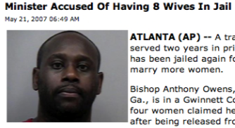
Ambiguous headlines
100%
REAL
Teacher Strikes Idle Kids
China to Orbit Human on Oct. 15
Red Tape Holds Up New Bridges
Hospitals Are Sued by 7 Foot Doctors
Juvenile Court to Try Shooting Defendant
Local High School Dropouts Cut in Half
Police: Crack Found in Man's Buttocks
Notes:
OK, what’s the joke here? What are the two readings? What is the source of ambiguity? Syntactic or semantic?
[walk through, elicit alternate readings, diagnose ambiguities]
Minister: PP attachment ambiguity
Teacher: very similar to “fruit flies” – both syntactic & semantic ambiguity
China: pure syntactic ambiguity
Crack: pure semantic ambiguity

Slide 23
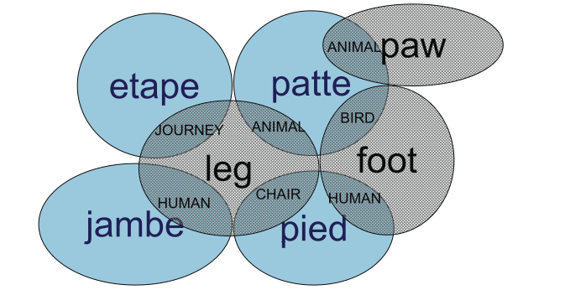
OK, why else is NLP hard?
Oh so many reasons!
non-standard English
segmentation issues
idioms
Great job @justinbieber! Were SOO PROUD of what youve accomplished! U taught us 2 #neversaynever & you yourself should never give up either♥
the New York-New Haven Railroad
the New York-New Haven Railroad
dark horse
get cold feet
lose face
throw in the towel
neologisms
garden path sentences
tricky entity names
unfriend
retweet
bromance
teabagger
The man who hunts ducks out on weekends.
The cotton shirts are made from grows here.
… a mutation on the for gene …
Where is A Bug’s Life playing …
Most of Let It Be was recorded …
world knowledge
prosody
lexical
specificity
Mary and Sue are sisters.
Mary and Sue are mothers.
I never said she stole my money.
I never said she stole my money.
I never said she stole my money.
But that’s what makes it fun!
Notes:
I’ve been focusing just on linguistic variability and ambiguity, but there are LOTS of other phenomena that make NLP hard.
In the interest of time, I won’t walk through all of these.
But let me just highlight one which is of particular importance these days.
Many of the most important commercial applications of NLP involve social media, trying to extract meaning from inputs which look like THIS.
But many of the tools we like to use – such as statistical parsers – have been trained on very clean, standard English text, such as the WSJ.
Not surprisingly, when you apply such models to inputs like this, they tend to fail pretty badly.
So this is a huge problem that we’re still struggling to deal with. [>]

Slide 24
So, how to make progress?
The task is difficult! What tools do we need?
  Knowledge about language
  Knowledge about the world
  A way to combine knowledge sources
The answer that’s been getting traction:
  probabilistic models built from language data
    P(“maison” → “house”) high
    P(“L’avocat général” → “the general avocado”) low
Some think this is a fancy new “A.I.” idea
  But really it’s an old idea stolen from the electrical engineers …
Notes:
OK, it’s hard. How do we make headway?
Well, over the last 15 years, the answer that’s been gaining traction is, we build probabilistic models from very large quantities of linguistic data.
So, for example, in machine translation, we’ll build a statistical model that will tell us that
the probability of translating “maison” as “house” is HIGH
but the probability of translating “L’avocat général” as “the general avocado” is LOW
EVEN THOUGH “avocat” does translate as “avocado”, and “général” does translate as “general”
now how could my model know that? [solicit ideas]
Now for the remainder of the class, I’m going to dive a little deeper on machine translation,
and I’ll try to give you just a taste of how statistical modeling is used to make machine translation work. [>]

Slide 25
Machine translation (MT)
The U.S. island of Guam is maintaining a high state of alert after the Guam airport and its offices both received an e-mail from someone calling himself the Saudi Arabian Osama bin Laden and threatening a biological/chemical attack against public places such as the airport.
美国关岛国际机场及其办公室均接获一名自称沙地阿拉伯富商拉登等发出的电子邮件，威胁将会向机场等公众地方发动生化袭击後，关岛经保持高度戒备。
The classic acid test for natural language processing.
Requires capabilities in both interpretation and generation.
About $10 billion spent annually on human translation.

Slide 26
Empirical solution
Parallel Texts: The Rosetta Stone
Hieroglyphs
Demotic
Greek
Notes:
Created in 196 BC. Rediscovered in 1799. Deciphered by Champollion in 1822. Enabled us to decipher Egyptian hieroglyphics, not just on this stone, but elsewhere. Now on display at the British Museum.

Slide 27
Empirical solution
Parallel Texts:
  Hong Kong Legislation
  Macao Legislation
  Canadian Parliament Hansards
  United Nations Reports
  European Parliament
  Instruction Manuals
  Multinational company websites
Hmm, every time one sees “banco”, translation is “bank” or “bench” …
If it’s “banco de…”, it
always becomes “bank”,
never “bench”…
slide from Kevin Knight

Slide 28

Sindarin-English
I amar prestar aen.
The world is changed.
Han mathon ne nen.
I feel it in the waters.
Han mathon ne chae.
I feel it in the earth.
A han noston ned 'wilith.
I smell it in the air.
Fellowship of the Rings movie script
slide from Lori Levin

Slide 29
Statistical MT
Suppose we had a probabilistic model of translation
P(e|f)
Example: suppose f is de rien
P(you’re welcome|de rien) = 0.45
P(nothing|de rien) = 0.13
P(piddling|de rien) = 0.01
P(underpants|de rien) = 0.000000001
Then the best translation for f is argmax_{e} P(e|f)
Notes:
Conventions:
we are always translating INTO English (of course it works the same in reverse, but let’s be consistent)
f always means foreign sentence – often French, but could be Spanish, or … which languages do you think are biggest focus of MT research today?
a probabilistic model of translation will give us probabilities for various translations into English of any given foreign phrase or sentence
so for example, if f is “de rien”, it might tell us …
now how would we build such a model?

Slide 30
A Bayesian approach
ê = argmax_{e} P(e|f)
P(f|e) P(e)
= argmax_{e}
P(f)
= argmax_{e} P(f|e) P(e)
translation model
translation model
(fidelity)
language model
language model
(fluency)
Notes:
We want the e which is the most likely translation of f.
Use Bayes’ Law to decompose this probability into two components.
(Why OK to drop denominator?)
Language model: a measure of FLUENCY
Translation model: a measure of FIDELITY
so what do we need to make this work? three things: (1) language model, (2) translation model, (3) decoder

Slide 31
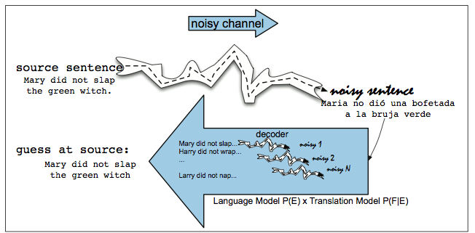
The “noisy channel” model
illustration from Jurafsky & Martin
Notes:
Noisy channel model: used in ASR, spelling correction, …
Reminds us of Weaver quote about decoding Russian.
The best English "decoding" of f is the sentence e which has the highest joint probability with f
And we break down the joint probability into two components:
(1) the probability that e occurs in the first place (language model), and
(2) the probability that e is "encoded" as f (translation model).
We look at everything backwards.

Slide 32
Language models (LMs)
Noisy channel model requires language model P(e)
LM tells us which sentences seem likely or “good”
Given some candidate translations, LM helps with:
  word choice (“shrank from” or “shrank of”?)
  word ordering (“tough decisions” or “decisions tough”?)
sentence | P(e)
He shrank from tough decisions. | 1.89e-11
He shrank from important decisions. | 9.46e-12
He shrank of tough decisions. | 7.11e-16
He shrank from decisions tough. | 3.21e-17

Slide 33
Statistical language models
Where will the language model come from?
We’ll build it by counting things in corpus data!
Statistical estimation of model parameters
But we can’t just count whole sentences
sentence | count | P(e)
He shrank from tough decisions. | 1/49208 | 2.03e-05
He shrank from important decisions. | 0/49208 | 0
He shrank of tough decisions. | 0/49208 | 0
He shrank from decisions tough. | 0/49208 | 0
too high!
too low!

Slide 34
N-gram language models
Instead, we’ll break things into pieces
This is called a bigram language model
We can estimate bigram probabilities from corpus
P(He shrank from tough decisions) =
P(He|•) × P(shrank|He) × P(from|shrank) × … × P(decisions|tough)
w₁ | w₂ | C(w₁) | C(w₁w₂) | P(w₂|w₁)
• | He | 49208 | 978 | 0.0199
He | shrank | 53142 | 21 | 0.0004
shrank | from | 122 | 17 | 0.1393
from | tough | 18777 | 184 | 0.0098

Slide 35
Statistical translation models
Noisy channel also needs translation model P(f|e)
Similar strategy: break sentence pairs into phrases
Count co-occurring pairs in a large parallel corpus
(But I’ll skip the gory details …)
e | f | C(e) | C(e, f) | P(f|e)
he shrank | il lui répugnait | 17 | 6 | 0.3529
from | de | 27111 | 17855 | 0.6586
from | des | 27111 | 6434 | 0.2373
tough decisions | décisions difficiles | 98 | 81 | 0.8265

Slide 36
Statistical MT Systems
French/English Parallel Texts
English Texts
Michelle ma belle sont les mots qui vont très bien ensemble
Michelle ma belle sont les mots qui vont très bien ensemble
Michelle ma belle sont les mots qui vont très bien ensemble
Michelle ma belle sont les mots qui vont très bien ensemble
Michelle ma belle sont les mots qui vont très bien ensemble
Michelle ma belle sont les mots qui vont très bien ensemble
Michelle, ma belle, sont les mots qui vont très bien ensemble
Michelle, my beautiful, are words that go together well
Many great traditions in art originated in the art of one of the five …
Statistical Analysis
Statistical Analysis
TranslationModel P(f|e)
Broken
English
Language Model P(e)
French
English
J’ai très faim
Decoding algorithm
argmax_{e} P(f|e) P(e)
I am so hungry
What hunger have I,
Hungry I am so,
I am so hungry,
Have I that hunger …

Slide 37
Applications of the noisy channel
This model can be applied to many different problems!
ê = argmax_{e} P(x|e) P(e)
Channel model
speech production
OCR
typing with spelling errors
translating to English
Language model
English words
English words
English words
English words
(Widely used at Google, for example)

Slide 38
If you like NLP / CompLing …
learn Java or Python (and play with JavaNLP or NLTK)
study logic, probability, statistics, linear algebra
get some exposure to linguistics (LING1, …)
study AI and machine learning (CS121, CS221, CS229)
read Jurafsky & Martin or Manning & Schütze
CS124: From Language to Information (Jurafsky)
CS224N: Natural Language Processing (Manning)
CS224S: Speech Recognition & Synthesis (Jurafsky)
CS224U: Natural Language Processing (MacCartney)

Slide 39
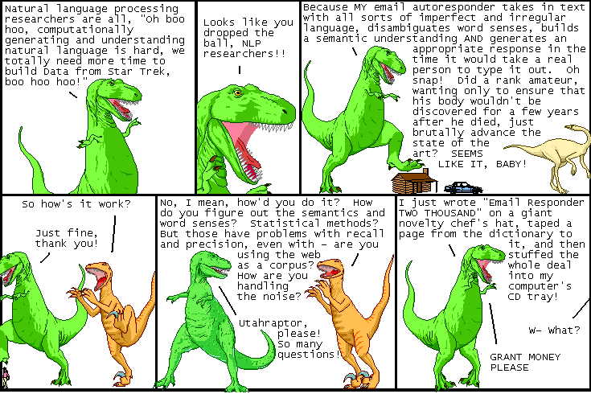
One more for the road
cartoon from qwantz.com

