Slide 1
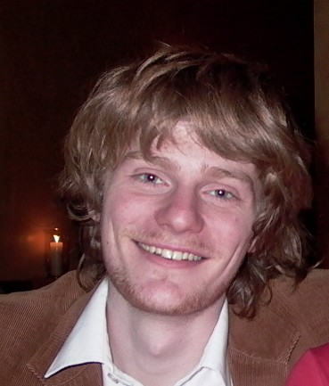
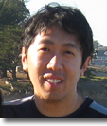
Deep Learning of Hierarchical Structure
Christopher Manning
Richard Socher & Andrew Ng
Learning Workshop 2011

Slide 2
Statistical Natural Language Processing: Two Successes & Two Failures

Slide 3
Statistical parsers are now used in applications and work rather well !
Same domain performance: 92.4% F1
WSJ train/test all lengths (Fossum & Knight 2009)
Different domain performance: 84.0% F1
Averaged results after adaptation (McClosky 2010)
Not great, not cruddy
Used in live applications
Product attribute and sentiment classification systems
(Shastri et al. 2010)
The best-known, large, deployed MT systems
(Marcu et al. 2006, Quirk & Corston-Oliver 2006, Xu et al. 2009)
Notes:
Shastri et al. is Infosys system at IAAI 2010. No idea if deployed or not

Slide 4
Statistical parsers are incredibly fragile because of their representations
A trivial difference like case throws the system!
Subject
Reduced that clause complement
Notes:
More linguistically interesting cases of this appear in languages with morphology!

Slide 5
Denser semantic word representations are good and improve all tasks
Representations of words that show their similarity, such as contexts of use, greatly help applications
+1.4% F1 Dependency Parsing
15.2% error reduction (Koo & Collins 2008)
+3.4% F1 Named Entity Recognition
23.7% error reduction (Stanford NER, exchange clust)
“You shall know a word by the company it keeps”
(J. R. Firth 1957: 11)

Slide 6
But we need to know about the semantic similarity of larger units
People represent the meaning of larger units – entities, groups, facts, arguments, stories – by semantic composition of smaller elements
How can we know when larger units are similar?
Two senators received contributions engineered by lobbyist Jack Abramoff in return for political favors.
Jack Abramoff attempted to bribe two legislators.
Our models must handle semantic composition

Slide 7
Confessions of a feature engineer
Most NLP systems make use of very carefully hand-designed features and representations
“Machine learning” reduces to just being numerical optimization
How can we learn – rather than manually design – our features?

Slide 8
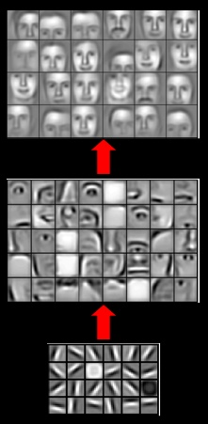
Deep belief networks
Deep neural networks have been very successful in unsupervised feature learning over sensory inputs
Audio, vision
But the representations used and learned are
Dense
Flat
Fixed size

Slide 9
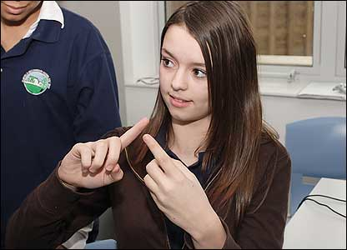
Human language
Human languages differ from other common signals in that they use a symbolic representation
Languages can use sound, images (writing), or gesture as a substrate, but language ends up a symbolic system
This creates problems for neural processing (sparsity!)
Why did language come to be that way? Who knows?
But, somehow we have to deal with it.

Slide 10
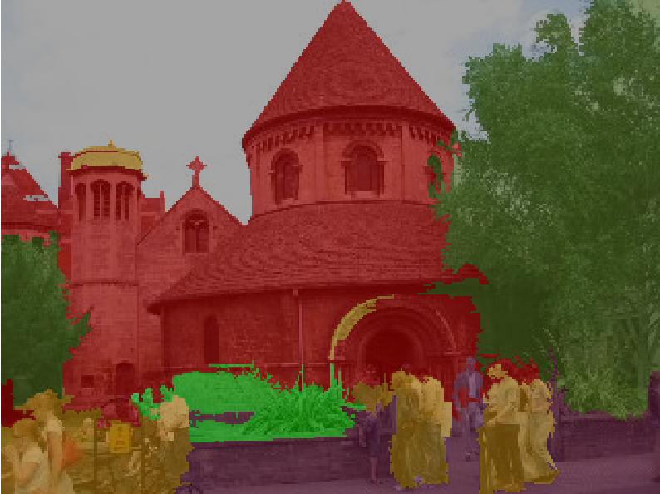
Outline
Goal: Algorithms that recover and use recursive structure in different modalities.
Motivations
Recursive Neural Networks for compositional natural language semantics
Parsing and paraphrasing results
Parsing natural scenes with RNNs
Recursive Autoencoders for sentiment prediction

Slide 11
Recursive Neural Networks for Compositional Natural Language Semantics
Richard Socher, Christopher Manning & Andrew Ng. NIPS 2010 workshop.

Slide 12
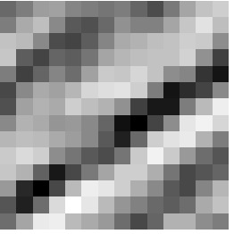
Sparse representations in language
Image representation
Language representation
One-hot vectors
to represent sequence of words
Sparse bag-of-word vector
0
0
0
0
1
0
0
0
0
1
0
0
0
0
0
0
0
0
0
1
0
0
0
0
0
1
0
1
1
0
0
0
Dense 196-dimensional vector
or
255
98
93
87
89
91
48
…
The cat sat ….

Slide 13
Creating dense representations
We embed each word in an n-dimensional space (cf. distributional representations)
2-d embedding example below, but in practice use ~100-d embeddings.
5
4
3
2
1
On
8
5
0
0
0
0
1
0
0
0
0
1
0
0
0
0
0
0
2
4
Monday
x₂
Tuesday
2.1
3.3
Britain
9
2
France
9.5
1.5
Monday Britain
0 1 2 3 4 5 6 7 8 9 10
x₁
On Monday, Britain ….
Representation:
8
5
2
4
9
2

Slide 14
Algorithms for finding word vector representations
Many distributional clustering ideas
(Salton et al., 1975; Brown et al., 1992; Pereira et al., 1993; Martin et al. 1998; Pantel & Lin, 2002; Clark 2003)
LSA (Landauer & Dumais, 1997); Latent Dirichlet Allocation (LDA; Blei et al., 2003)
Each represents a word via the statistics of what it co-occurs with.
Recent development: “Neural language models”
(Bengio et al., 2003. Collobert & Weston, 2008)
Learn a separate parameter vector for each word that summarizes its co-occurrence with other words.
Formally, learn an embedding f(w) of each word w so that you can estimate a language model as:
Not necessarily better, but what we use!
(Turian et al. 2010; Christodoulopoulos et al. 2010)
Notes:
Also: Rapp, 2003; Turney et al., 2003
We use Collobert & Weston 2008.

Slide 15
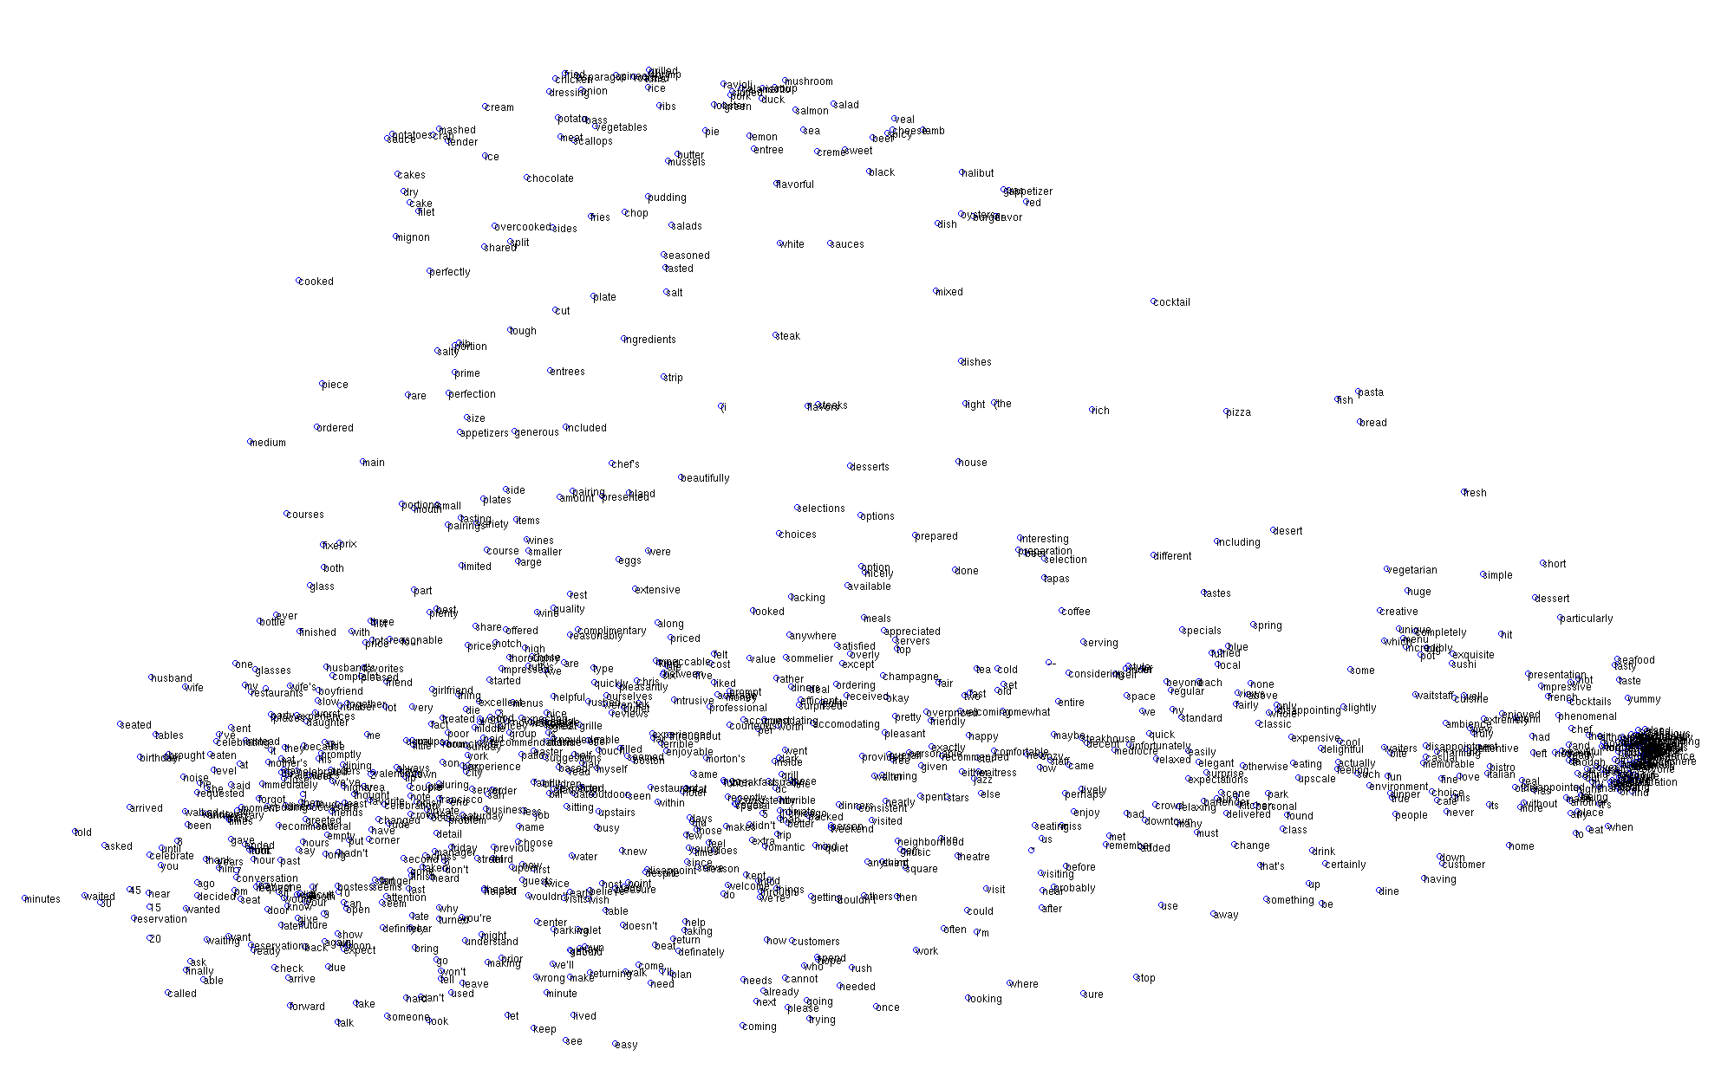
Learned word representation
[Images from Joseph Turian, Lev Ratinov and Yoshua Bengio 2010]

Slide 16
Notes:
Has nice scaling properties. E.g., neuron can’t get a higher score just by firing twice as often.

Slide 17
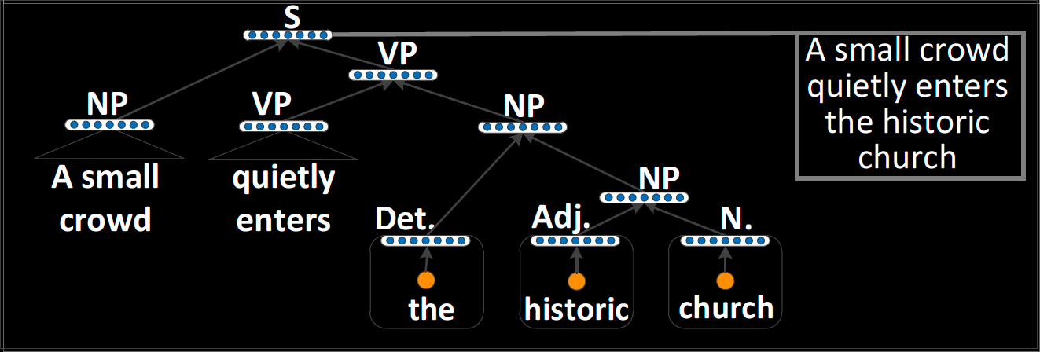
Recursive structure in language
Natural language is recursive
Sentences contain noun phrases that contain relative clauses that themselves contain noun phrases
Notes:
The hierarchical and recursive structure of natural language.
The sentence in the second level bullet is an example of itself.

Slide 18
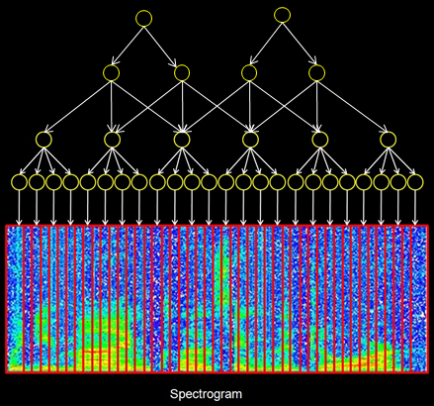
The hierarchical structure of language
Audio/Images
Language
“Generic” hierarchies
Recursive structure
Input-specific hierarchy
Notes:
Compositionality!
Variable length input, recursive structure

Slide 19
A “generic” hierarchy on natural language doesn’t make sense
Node has to represent sentence fragment “cat sat on.” Doesn’t make sense.
9
1
5
3
7
1
8
5
9
1
4
3
The cat sat
on the mat.
Feature representation for words

Slide 20
What we want (illustration)
S
This node’s job is to represent “on the mat.”
VP
PP
NP
NP
9
1
5
3
7
1
8
5
9
1
4
3
The cat sat
on the mat.

Slide 21
What we want (illustration)
5
4
S
This node’s job is to represent “on the mat.”
7
3
VP
8
3
PP
5
2
NP
3
3
NP
9
1
5
3
7
1
8
5
9
1
4
3
The cat sat
on the mat.

Slide 22
What we want (illustration)
5
4
3
2
1
The day after my birthday
x₂
Monday
Tuesday
The country of my birth
Britain
France
0 1 2 3 4 5 6 7 8 9 10
x₁
3
5
9
3
8
3
9
2
5
2
3
3
2
8
3
2
8
5
2
4
9
2
3
2
9
2
8
5
9
2
9
9
3
2
2
2
The day after my birthday, …
The country of my birth…

Slide 23
Solution: Recursive Neural Networks for structure prediction
Inputs: two candidate children’s representations
Outputs:
The semantic representation if the two nodes are merged
Score of how plausible the new node is
This node’s job is to represent “on the mat.”
8
3
1.3
8
3
3
3
Neural
Network
8
5
9
1
4
3
on the mat.
8
5
3
3
Notes:
In the past only used to rank or classify given an existing structure (from a symbolic system)

Slide 24
Solution: Recursive Neural Networks for structure prediction
Basic computational unit of Recursive Neural Network
Early RNN work (Goller & Küchler 1996 assumed fixed tree structure
Henderson (2003), Titov & Henderson (2007) use NN for parse decision prediction but not representation
Costa et al. (2003) use RNN for PP attachment, but on one hot vectors
1.3
8
3
Neural
Network
s = W^{score}p
p = f(W[c₁;c₂] + b)
8
5
3
3
Notes:
Previous work on RNNs assumed fixed tree structures; here we don’t.

Slide 25
Parsing a sentence
5
2
0
1
0
1
0
0
3
3
3.1
0.3
0.1
0.4
2.3
Neural
Network
Neural
Network
Neural
Network
Neural
Network
Neural
Network
9
1
5
3
7
1
8
5
9
1
4
3
The cat sat
on the mat.

Slide 26
Parsing a sentence
2
1
1.1
Neural
Network
0
0
0
1
3
3
0.1
0.4
2.3
5
2
Neural
Network
Neural
Network
Neural
Network
9
1
5
3
7
1
8
5
9
1
4
3
The cat sat
on the mat.

Slide 27
Parsing a sentence
2
1
8
3
1.1
3.6
Neural
Network
Neural
Network
0
1
0.1
5
2
Neural
Network
3
3
9
1
5
3
7
1
8
5
9
1
4
3
The cat sat
on the mat.

Slide 28
Parsing a sentence
5
4
7
3
8
3
5
2
3
3
9
1
5
3
7
1
8
5
9
1
4
3
The cat sat
on the mat.

Slide 29
Details, details, details
Previous example is maximally Greedy
We may benefit from including context – the word to the left and right – into the decision
Cf. Klein & Manning 2002
They are added to the RNN computational unit

Slide 30
Details, details, details
Similar to max-margin parsing (Taskar et al. 2004), we can formulate a Global structure risk optimization problem using a parse chart
Where the score is the sum of local parsing decision scores from the RNN
We explore this by computing 1-best for each span
Notes:
Neural network is trained discriminatively, with CKY in the inner-loop, to optimize a large margin objective. (Similar to max margin parsing, Taskar et al., 2004)
Not really greedy. Done with CKY chart parser.

Slide 31
Details, details, details
PP
We can make each node’s representation the input to a softmax layer that is trained to classify the syntactic category of the node
Such as NP, VP, PP, …
This doesn’t replace the embedding representation, but informs it
Softmax
Layer
8
3
Neural
Network
Supervised learning is done via
standard backpropagation through structure (Goller et al. 1996)
subgradient ascent (Ratliff et al. 2007) for Global loss objective

Slide 32
Parsing and Paraphrasing with Recursive Neural Networks
Richard Socher, Yves Peirsman, Christopher Manning & Andrew Ng. submitted.

Slide 33
Experiments: Parsing
Model | L15 Dev | L15 Test | All Dev | All Test
RNN 1 (Greedy) | 76.6
RNN 2 (Greedy, context) | 83.4
RNN 3 (Greedy, context, category) | 87.1
RNN 4a (Global, context) | 91.2
RNN 4b (Global, context, category) | 92.1 | 90.3 | 83.5 | 83.1
Sigmoid NN (Titov & Henderson 2007) | 89.5 | 89.3 | 89.2 | 88.6
Berkeley Parser (Petrov & Klein 2006) | 92.1 | 91.6 | 92.2 | 91.6
Standard WSJ train/test
Reasonable results, but not as good on longer sentences
More to do….

Slide 34
Semantic similarity: nearest neighbors
All the figures are adjusted for seasonal variations
1. All the numbers are adjusted for seasonal fluctuations
2. All the figures are adjusted to remove usual seasonal patterns
Knight-Ridder would n’t comment on the offer
1. Harsco declined to say what country placed the order
2. Coastal would n’t disclose the terms
Sales grew almost 7% to $UNK m. from $UNK m.
1. Sales rose more than 7% to $94.9 m. from $88.3 m.
2. Sales surged 40% to UNK b. yen from UNK b.
Notes:
This shows the ability of the system to capture semantic similarity in the embedding space!

Slide 35
Paraphrase detection task
Goal is to say which of candidate phrases are a good paraphrase of a given phrase
Motivated by Machine Translation
Initial algorithms (Bannard & Callison-Burch 2005, Callison-Burch 2008) exploit bilingual sentence-aligned corpora and hand-built linguistic constraints
We simply re-use our system learned on parsing the WSJ
We set one threshold parameter on dev data

Slide 36
Paraphrase detection task
Target | Candidates with human goodness label (1–5) ordered by our system
the united states | the usa (5) the us (5) united states (5) north america (4) united (1) the (1) of the united states (3) america (5) nations (2) we (3)
it would be | it would represent (5) there will be (2) that would be (3) it would be ideal (2) it would be appropriate (2) it is (3) it would (2) would be (2)
around the world | around the global (5) throughout the world (5) across the world (5) over the world (2) in the world (5) of the budget (2) of the world (5)
of capital punishment | of the death penalty (5) to death (2) the death penalty (2) of (1)
in the long run | in the long term (5) in the short term (2) for the longer term (5) in the future (5) in the end (3) in the long-term (5) in time (5) of the (1)
Notes:
Note that it’s not very good with antonyms!

Slide 37
RNN improves paraphrase detection
System | P | R | F1
Bannard & Callison-Burch 2005 | 0.28 | 0.12 | 0.17
Callison-Burch 2008 CB7 | 0.52 | 0.17 | 0.26
RNN (this work) | 0.38 | 0.64 | 0.48
RNN-CB7 (this work & CB7 combined) | 0.53 | 0.20 | 0.29
Notes:
Okay to omit 2 ave lines?

Slide 38
Parsing Natural Scenes with Recursive Neural Networks
Richard Socher, Cliff Lin, Christopher Manning and Andrew Ng. ICML 2011.

Slide 39
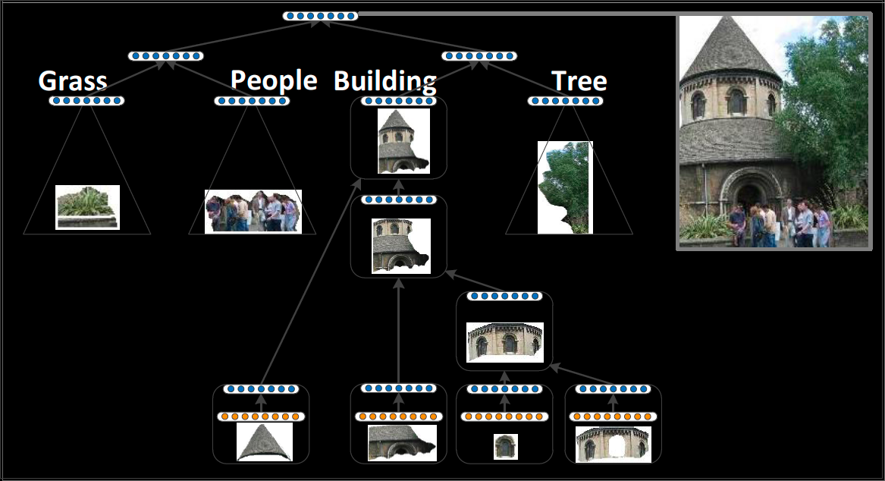
Recursive Structure in Images
One also finds nested hierarchical structure in scene images that capture both part-of and proximity relationships
Notes:
Large object regions contain smaller object regions of the same
Algorithm learns a “representation” for each node of hierarchy

Slide 40
Differences for 2d Image Parsing

Slide 41
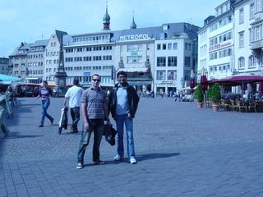
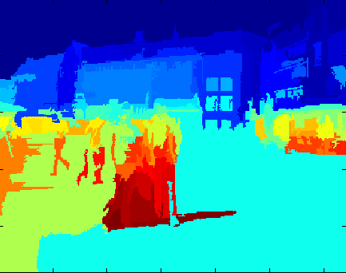
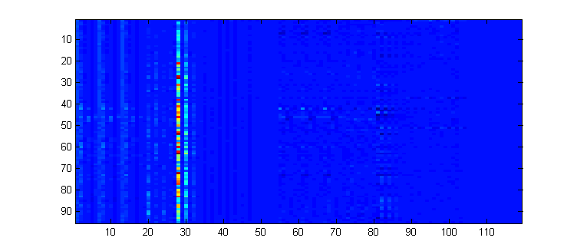
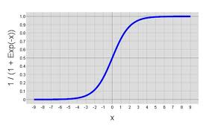
Mapping Segments into Syntactico-Semantic Space
Oversegment the image →
Extract Features for each segment
Color Histograms
Shape Features
Area, Texture
++ (see Gould et al., 2009)
Map Features into semantic space with a linear + sigmoid layer:
Notes:
Still supervised training

Slide 42
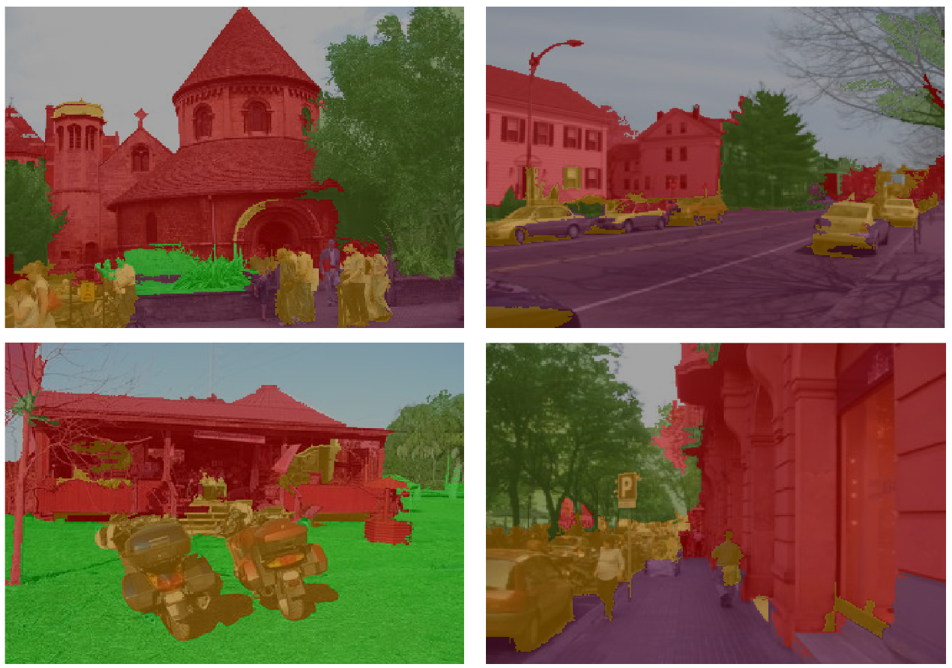
Experiments: Scene Understanding
Goals
Object Segmentation & Classification
Scene Classification
Stanford Background Dataset
(Gould et al. 2009)
8 classes

Slide 43
Multi-class segmentation Stanford background dataset
Method | Accuracy
Pixel CRF (Gould et al., ICCV 2009) | 74.3%
Classifier on superpixel features | 75.9%
Region-based energy (Gould et al., ICCV 2009) | 76.4%
Local labelling (Tighe & Lazebnik, ECCV 2010) | 76.9%
Superpixel MRF (Tighe & Lazebnik, ECCV 2010) | 77.5%
Simultaneous MRD (Tighe & Lazebnik, ECCV 2010) | 77.5%
Our Recursive Neural Network | 78.1%
Clarkson and Moreno (1999): 77.6%
Gunawardana et al. (2005): 78.3%
Sung et al. (2007): 78.5%
Petrov et al. (2007): 78.6%
Sha and Saul (2006): 78.9%
Yu et al. (2009): 79.2%
Notes:
Pixel-level accuracy

Slide 44
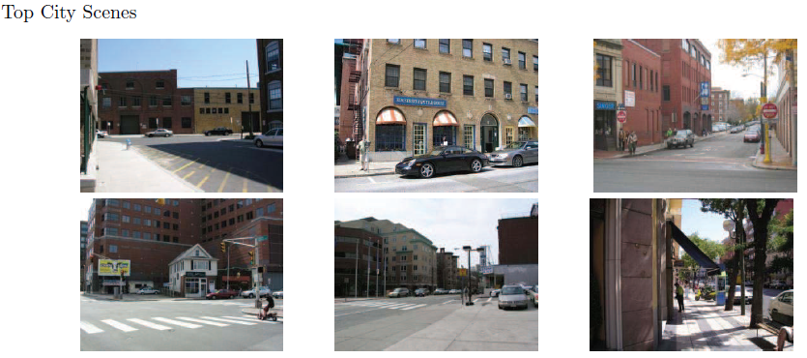
Experiments: Scene Understanding
Task: classify scene as: City, Countryside, Seaside
Model | Accuracy
RNN (this work) top node only | 71.0%
Gist descriptors | 84.0%
RNN (this work) all nodes, lin. SVM | 88.1%

Slide 45
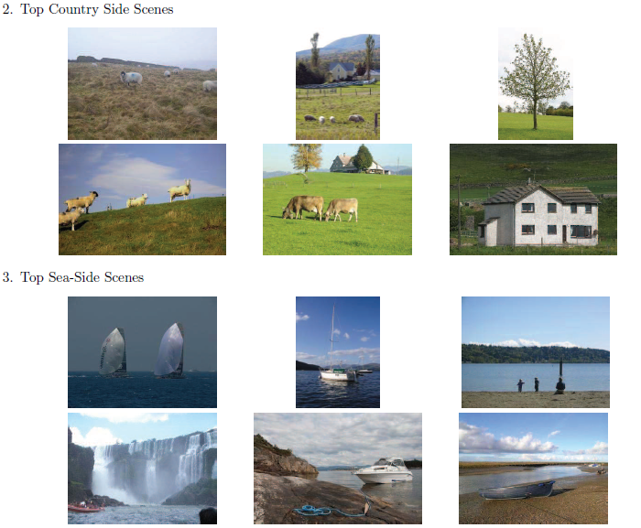
Experiments: Scene Understanding

Slide 46
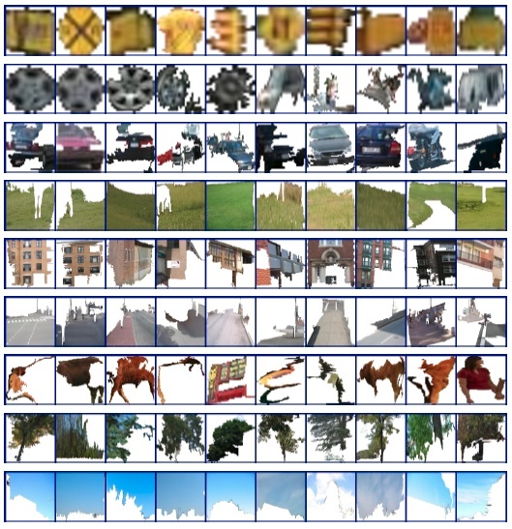
Nearest neighbors for image patches
Each node in the hierarchy (e.g., set of merged superpixels) has a feature vector
Select a node and list nearest neighbor nodes in embedding
What image patches get mapped to similar features?
Selected patch
Nearest Neighbors

Slide 47
A Recursive Autoencoder for predicting Sentiment Distributions
Richard Socher, Jeffrey Pennington, Eric Huang, Christopher Manning and Andrew Ng. EMNLP 2011.

Slide 48
Sentiment distributions
Sentiment classification or is a current hot topic in real world text analytics
Crucial to business intelligence (marketing, customer feedback), stock trading, …
Most methods start with a bag of words and add some more linguistic features/processing/lexica
But such methods can’t distinguish
white blood cells destroying an infection
an infection destroying white blood cells

Slide 49
Recursive Autoencoder
We use a semi-supervised recursive autoencoder
It learns a tree representation unsupervised
Not done in previous work like RAAM (Pollack 1990)
It learns from a sentiment distribution

Slide 50
Unsupervised Recursive Autoencoder

Slide 51
Semisupervised Recursive Autoencoder
We add a softmax layer to each node which is trained against the global sentiment distribution
Error is a weighted combination of reconstruction error and cross-entropy (distribution likelihood)

Slide 52
+/– sentiment classification
Results on movie reviews (MR) and opinions (MPQA), two commonly used data sets
Method | MR | MPQA
Phrase voting with lexicons | 63.1 | 81.7
Bag of features with lexicons | 76.4 | 84.1
Tree-CRF (Nakagawa et al. 2010) | 77.3 | 86.1
RAE (this work) | 77.7 | 86.0
Notes:
But feelings in general are not a 1-dimensional scale from good to bad

Slide 53
Learning Compositionality from Movie Reviews
Probability of being positive of several n-grams
n-gram | P(positive | n-gram)
good | 0.45
not good | 0.20
very good | 0.61
not very good | 0.15
not | 0.03
very | 0.23
Notes:
“Not very” is more indicative of negativity and pragmatically often used ironically
Learning Compositionality from Movie Reviews

Slide 54
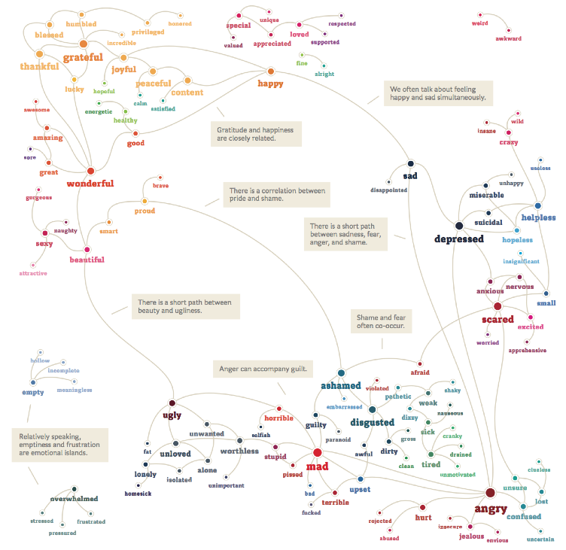
Notes:
Sep Kamvar from We Feel Fine: The Emotional Graph.

Slide 55
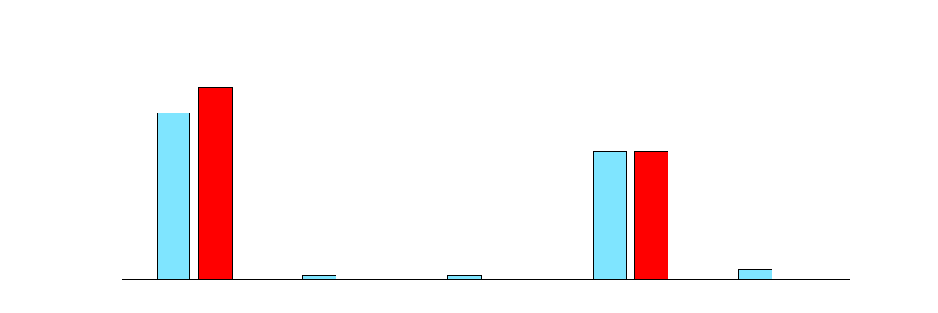
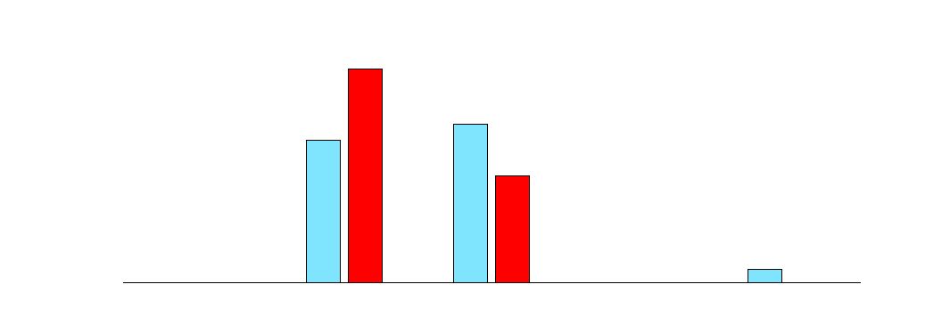
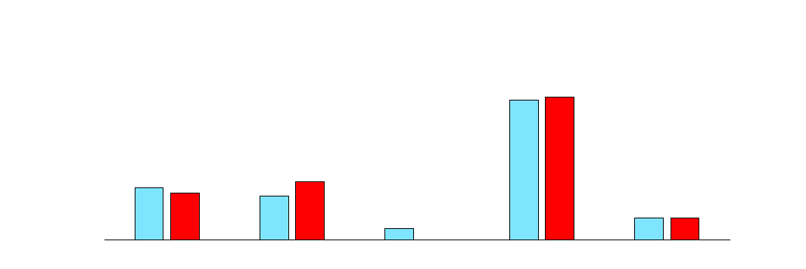
Sentiment distributions
Experience Project user labels
Sorry, Hugs | You rock | Tee-hee | I understand | Wow, just wow
http://www.experienceproject.com/confessions.php
 | I am 13 years old and i hate my father he is alwas geting drunk and do’s not care about how it affects me or my sisters i want to care but the truthis i dont care if he dies
 | well i think hairy women are attractive
 | Dear Love, I just want to say that I am looking for you. Tonight I felt the urge to write, and I am becoming more and more frustrated that I have not found you yet. I’m also tired of spending so much heart on an old dream. ...
Notes:
Sorry, hugs – You rock – Teehee – I understand – Wow, just wow
Ground truth is red, predicted is blue.
We have KL-divergence = data likelihood results for this, but they’re a bit hard to interpret, so going back to classification….

Slide 56
Experience Project most votes results
Method | Accuracy %
Random | 20
Most frequent class | 38
Bag of words; maximum entropy classifier | 46
Spellchecker, sentiment lexica, SVM | 47
SVM on neural net word features | 46
RAE (this work) | 50

Slide 57
Summary
Recursive Neural Networks are a versatile model for feature learning, structure prediction and classification, handling
Variable sized inputs
Sparse inputs
Inputs with example-specific hierarchical structure
Thanks again to:
Richard Socher
Andrew Ng

