Slide 1
Natural Language Processing Tools for the Digital Humanities
Christopher Manning
Stanford University
Digital Humanities 2011
http://nlp.stanford.edu/~manning/courses/DigitalHumanities/

Slide 2
Commencement 2010
Notes:
My humanities qualifications

Slide 3
My humanities qualifications
B.A. (Hons), Australian National University
Ph.D. Linguistics, Stanford University
But:
I’m not sure I’ve ever taken a real humanities class (if you discount linguistics classes and high school English…)
Notes:
And so, I think I don’t have a very good model of the audience

Slide 4
So, feel free to ask questions!

Slide 5
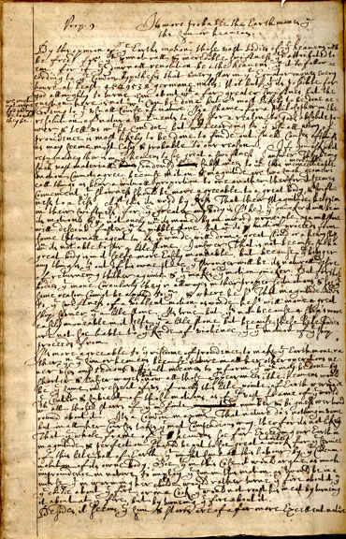
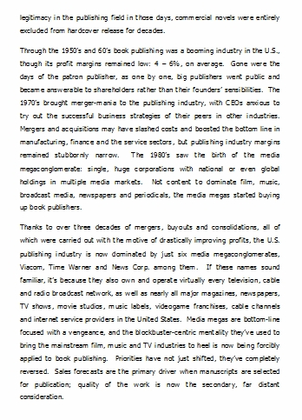
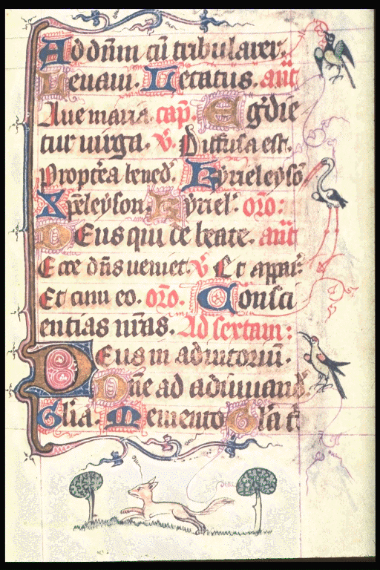
Text
Notes:
Text is complex , especially from a humanistic perspective.
The main traditional mode of scholarship has been micro-scale close textual reading.
But a new world provides opportunities for macro-scale analyses.
The old academic world was one of scarce resources.
The new academic world is that you cannot read everything being produced.
For certain historical fields, you may still be able to read all the primary texts, but the general attitude should be:
You cannot read everything.
This emphasizes the role of macro-scale studies and text mining.
(Of course, information overload has been around for centuries. It just keeps getting worse.)
Such methods may provide new and complementary insights.
How did portrayals of women in British fiction relate to the rise of the New Woman at the end of the nineteenth century?
How did the imperialist romance genre both respond to and reinforce a sense of rightful white empires?
Explore the relationship between male quest romances and supporting an imperialist agenda in nineteenth century British literature
The question of what can be gotten out of the text by rote computation is puzzing and (rightly) treated with skepticism.
Henry Bellingham’s Bookhttp://web.utk.edu/~scopela2/Bellingham_Commonplace_Book/read/manuscriptJPGs_1200px_wide/BellinghamCB178V.jpg

Slide 6
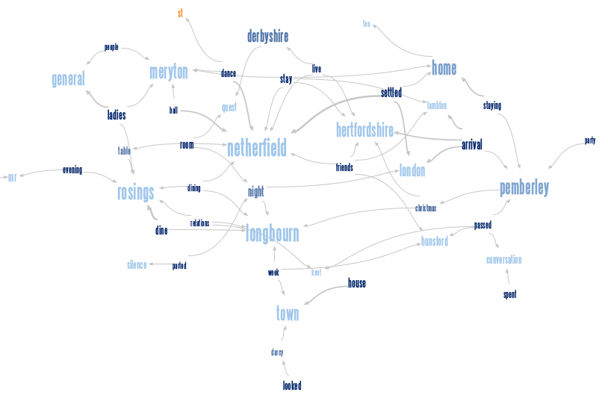
The promise
Phrase Net visualization of
Pride & Prejudice (* (in|at) *)
http://www-958.ibm.com/software/data/cognos/manyeyes/

Slide 7
“How I write” [code]
I think you tend to get too much of people showing the glitzy output of something
So, for this tutorial, at least in the slides I’m trying to include the low-level hacking and plumbing
It’s a standard truism of data mining that more time goes into “data preparation” than anything else. Definitely goes for text processing.

Slide 8
Outline
Introduction
Getting some text
Words
Collocations, etc.
NLP Frameworks and tools
Part-of-speech tagging
Named entity recognition
Parsing
Coreference resolution
The rest of the languages of the world
Parting words

Slide 9
2. Getting some text

Slide 10
First step: Text
To do anything, you need some texts!
Many sites give you various sorts of search-and-display interfaces
But, normally you just can’t do what you want in NLP for the Digital Humanities unless you have a copy of the texts sitting on your computer
This may well change in the future: There is increasing use of cloud computing models where you might be able to upload code to run it on data on a server
or, conversely, upload data to be processed by code on a server

Slide 11
First step: Text
People in the audience are probably more familiar with the state of play here than me, but my impression is:
There are increasingly good supplies of critical texts in well-marked-up XML available commercially for license to university libraries
There are various, more community efforts to produce good digitized collections, but most of those seem to be available to “friends” rather than to anybody with a web browser
There’s Project Gutenberg ☺
Plain text, or very simple HTML, which may or may not be automatically generated
Unicode utf-8 if you’re lucky, US-ASCII if you’re not

Slide 12
1. Early English Books Online
TEI-compliant XML texts
http://eebo.chadwyck.com/
Notes:
Chadwyck Healey

Slide 13
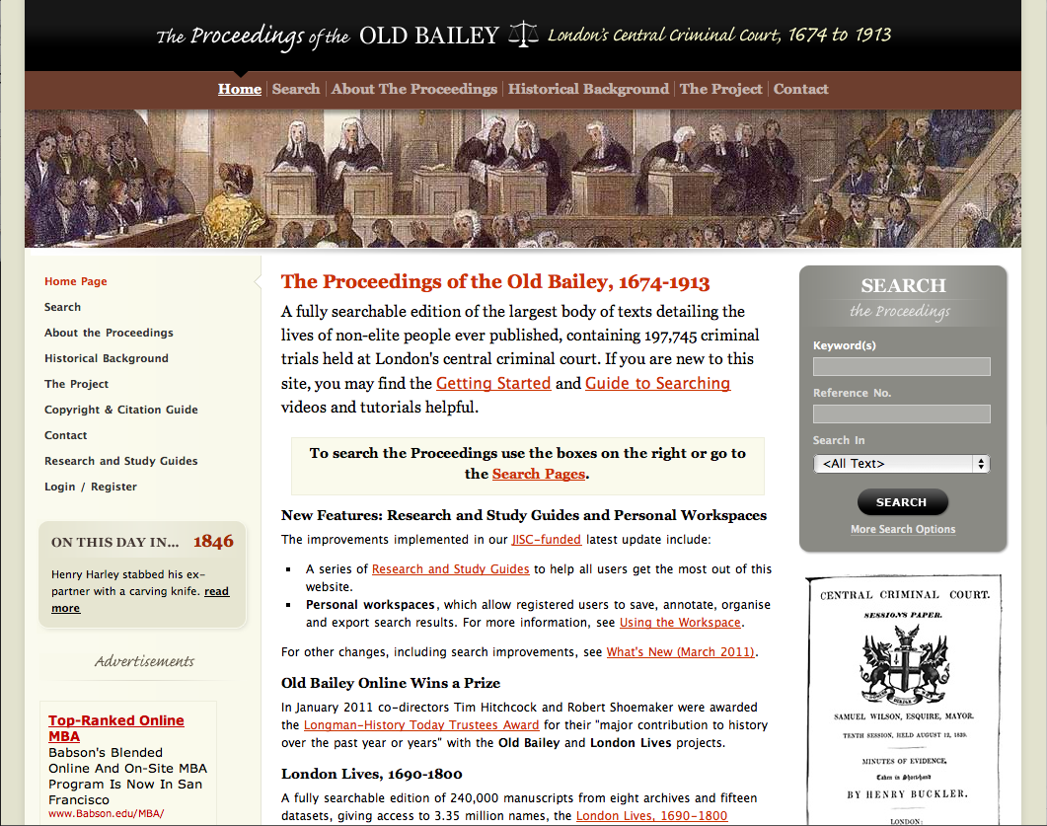
2. Old Bailey Online

Slide 14
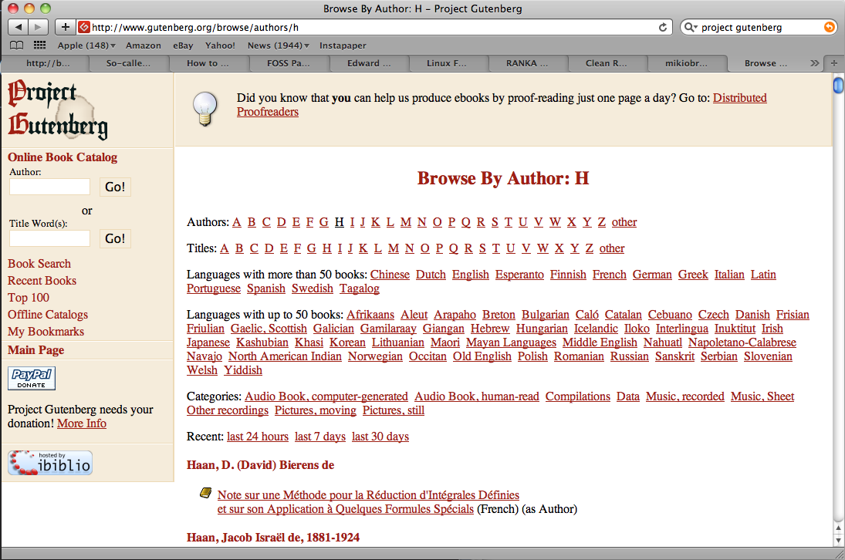
3. Project Gutenberg

Slide 15
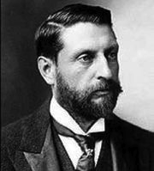
Running example: H. Rider Haggard
The hugely popular King Solomon's Mines (1885) by H. Rider Haggard is sometimes considered the first of the “Lost World” or “Imperialist Romance” genres
Zip file at: http://nlp.stanford.edu/~manning/courses/DigitalHumanities/
Allan Quatermain (1887)
She (1887)
Nada the Lily (1892)
Ayesha: The Return of She (1905)
She and Allan (1921)

Slide 16
Interfaces to tools
Web applications
Programming
APIs
GUI applications
Command-line applications
Most NLP tools are on this side

Slide 17
You’ll need to program
Lisa Spiro, TAMU Digital Scholarship 2009:
I’m a digital humanist with only limited programming skills (Perl & XSLT). Enhancing my programming skills would allow me to:
Avoid so much tedious, manual work
Do citation analysis
Pre-process texts (remove the junk)
Automatically download web pages
And much more…

Slide 18
You’ll need to program
Program in what?
Perl
Traditional seat-of-the-pants scripting language for text processing (it nailed flexible regex). I use it some below….
Python
Cleaner, more modern scripting language with a lot of energy, and the best-documented NLP framework, NLTK.
Java
There are more NLP tools for Java than any other language. And it’s one of those most popular languages in general. Good regular expressions, Unicode, etc.

Slide 19
You’ll need to program
Program with what?
There are some general skills that you’ll want the cut across programming languages
Regular expressions
XML, especially XPath and XSLT
Unicode
But I’m wisely not going to try to teach programming or these skills in this tutorial ☺

Slide 20
Grabbing files from websites
wget (Linux) or curl (Mac OS X, BSD)
wget http://www.gutenberg.org/browse/authors/h
curl -O http://www.gutenberg.org/browse/authors/h
If you really want to use your browser, there are things you can get like this Firefox plug-in
DownThemAll http://www.downthemall.net/
but then you just can’t do things as flexibly

Slide 21
Grabbing files from websites
#!/usr/bin/perl
while (<>) { last if (m/Haggard/); }
while (<>) {
last if (m/Hague/);
if (m!pgdbetext\"><a href="/ebooks/(\d+)">(.*)</a> \(English\)!) {
$title = $2;
$num = $1;
$title =~ s/<br>/ /g;
$title =~ s/\r//g;
print "curl -o \"$title $num.txt\" http://www.gutenberg.org/cache/epub/$num/pg$num.txt\n";
# Expect only one of the html to exist
print "curl -o \"$title $num.html\" http://www.gutenberg.org/files/$num/$num-h/$num-h.htm\n";
print "curl -o \"$title $num-g.html\" http://www.gutenberg.org/cache/epub/$num/pg$num.html\n";
}
}

Slide 22
Grabbing files from websites
wget http://www.gutenberg.org/browse/authors/h
perl getHaggard.pl < h > h.sh
chmod 755 h.sh
./h.sh
# and a bit of futzing by hand that I will leave out….
Often you want the 90% solution: automating nothing would be slow and painful, but automating everything is more trouble than it’s worth for a one-off process

Slide 23
Typical text problems
"Devilish strange!" thought he, chuckling to himself; "queer business! Capital trick of the cull in the cloak to make another person's brat stand the brunt for his own---capital! ha! ha! Won't do, though. He must be a sly fox to get out of the Mint without my
[Page 59 ]
knowledge. I've a shrewd guess where he's taken refuge; but I'll ferret him out. These bloods will pay well for his capture; if not, he'll pay well to get out of their hands; so I'm safe either way---ha! ha! Blueskin," he added aloud, and motioning that worthy, "follow me."
Upon which, he set off in the direction of the entry. His progress, however, was checked by loud acclamations, announcing the arrival of the Master of the Mint and his train.
Baptist Kettleby (for so was the Master named) was a "goodly portly man, and a corpulent," whose fair round paunch bespoke the affection he entertained for good liquor and good living. He had a quick, shrewd, merry eye, and a look in which duplicity was agreeably veiled by good humour. It was easy to discover that he was a knave, but equally easy to perceive that he was a pleasant fellow; a combination of qualities by no means of rare occurrence. So far as regards his attire, Baptist was not seen to advantage. No great lover of state or state costume at any time, he was
[Page 60 ]
generally, towards the close of an evening, completely in dishabille, and in this condition he now presented himself to his subjects. His shirt was unfastened, his vest unbuttoned, his hose ungartered; his feet were stuck into a pair of pantoufles, his arms into a greasy flannel dressing-gown, his head into a thrum-cap, the cap into a tie-periwig, and the wig into a gold-edged hat. A white apron was tied round his waist, and into the apron was thrust a short thick truncheon, which looked very much like a rolling-pin.
The Master of the Mint was accompanied by another gentleman almost as portly as himself, and quite as deliberate in his movements. The costume of this personage was somewhat singular, and might have passed for a masquerading habit, had not the imperturbable gravity of his demeanour forbidden any such supposition. It consisted of a close jerkin of brown frieze, ornamented with a triple row of brass buttons; loose Dutch slops, made very wide in the seat and very tight at the knees; red stockings with black clocks, and
[Page 61 ]
a fur cap. The owner of this dress had a broad weather-beaten face, small twinkling eyes, and a bushy, grizzled beard. Though he walked by the side of the governor, he seldom exchanged a word with him, but appeared wholly absorbed in the contemplations inspired by a broad-bowled Dutch pipe.

Slide 24
There are always text-processing gotchas …
… and not dealing with them can badly degrade the quality of subsequent NLP processing.
The Gutenberg *.txt files frequently represent italics with _underscores_.
There may be file headers and footers
Elements like headings may be run together with following sentences if not demarcated or eliminated (example later).

Slide 25
There are always text-processing gotchas …
#!/usr/bin/perl
$finishedHeader = 0;
$startedFooter = 0;
while ($line = <>) {
if ($line =~ /^\*\*\*\s*END/ && $finishedHeader) {
$startedFooter = 1;
}
if ($finishedHeader && ! $startedFooter) {
$line =~ s/_//g; # minor cleanup of italics
print $line;
}
if ($line =~ /^\*\*\*\s*START/ && ! $finishedHeader) {
$finishedHeader = 1;
}
}
if ( ! ($finishedHeader && $startedFooter)) {
print STDERR "**** Probable book format problem!\n";
}

Slide 26
3. Words

Slide 27
In the beginning was the word
Word counts
Word counts are the basis of all the simple, first order methods of text analysis
tag clouds, collocations, topic models
Sometimes you can get a fair distance with word counts

Slide 28
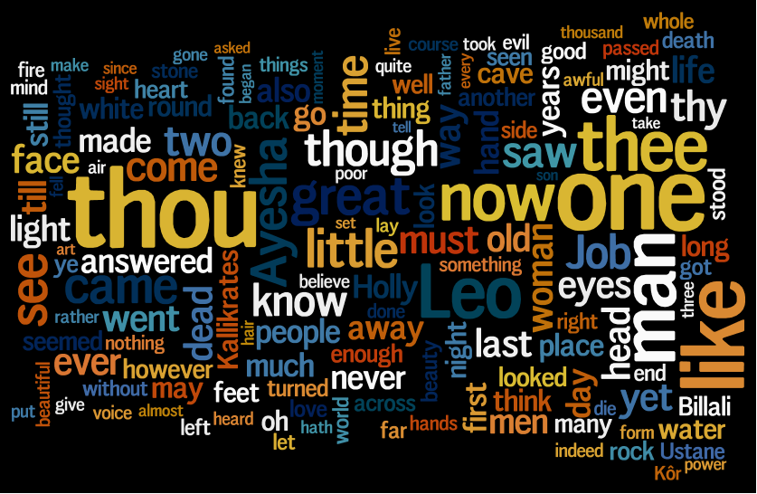
She (1887)
http://wordle.net/ Jonathan Feinberg
Notes:
Wordle cloud for She 1887
wordle.net
Jonathan Feinberg

Slide 29
Ayesha: The Return of She (1905)
Notes:
Ayesha, the return of She. 1905

Slide 30
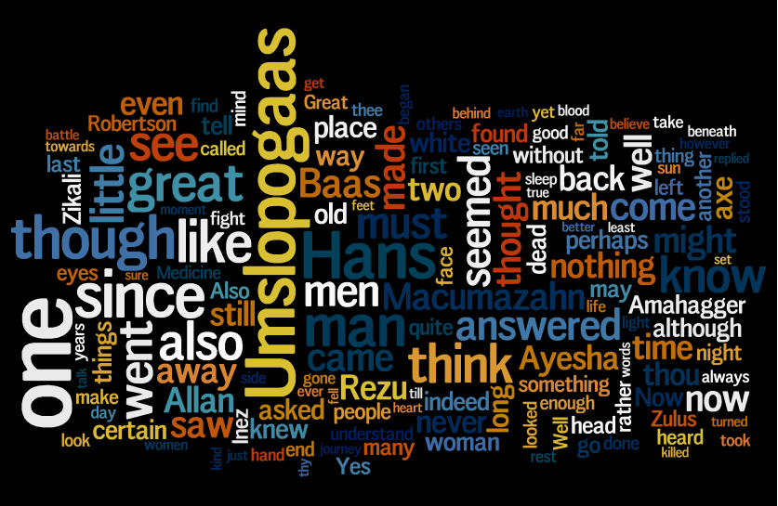
She and Allan (1921)
Notes:
She and Allan 1921

Slide 31
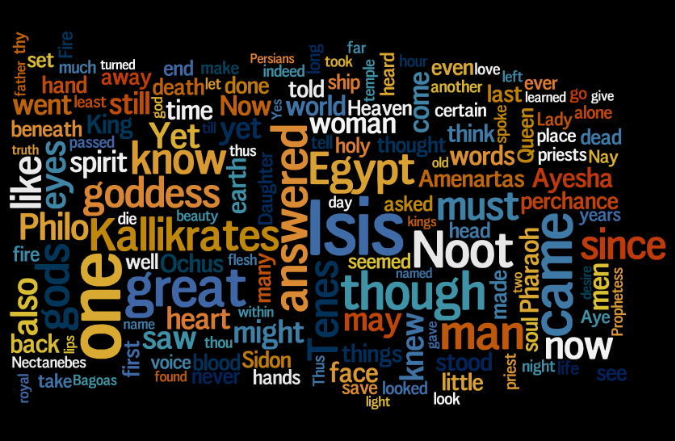
Wisdom's Daughter: The Life and Love Story of She-Who-Must-Be-Obeyed (1923)
Notes:
Wisdom's Daughter: The Life and Love Story of She-Who-Must-Be-Obeyed 1923

Slide 32
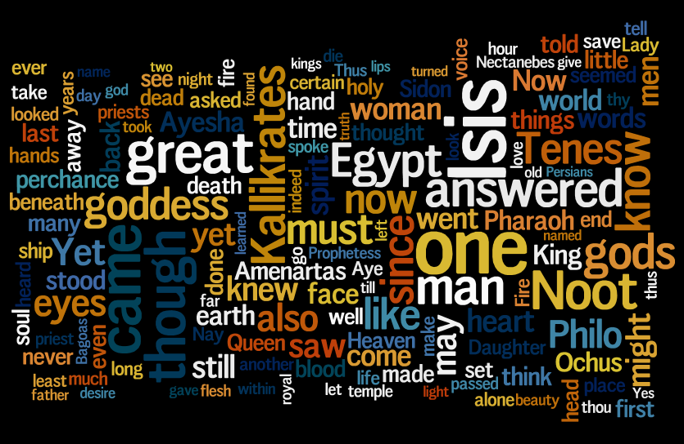
Wisdom's Daughter: The Life and Love Story of She-Who-Must-Be-Obeyed (1923)
Notes:
While Wordle word size reflects frequency it uses randomization in the layout and choice of color. Centrality effects human perceptions. So a different role of the dice can end up with quite different words being emphasized.

Slide 33
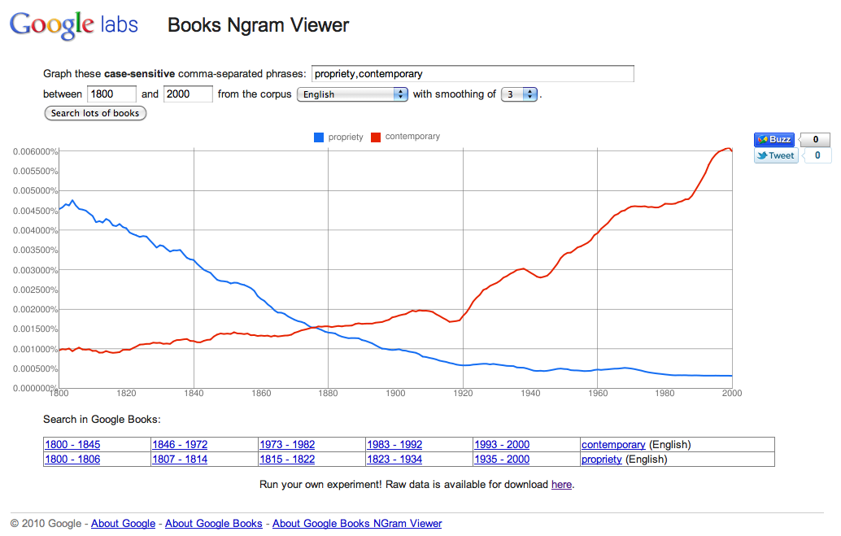
Google Books Ngram Viewer http://ngrams.googlelabs.com/
Notes:
propriety, contemporary
honour is also in a long decline
native
Zulus
vengeance is long decline

Slide 34
Google Books Ngram Viewer
… you have to be the most jaded or cynical scholar not to be excited by the release of the Google Books Ngram Viewer … Digital humanities needs gateway drugs. … “Culturomics” sounds like an 80s new wave band. If we’re going to coin neologisms, let’s at least go with Sean Gillies’ satirical alternative: Freakumanities.… For me, the biggest problem with the viewer and the data is that you cannot seamlessly move from distant reading to close reading

Slide 35
Language change: as least as
C. D. Manning. 2003. Probabilistic Syntax
I found this example in Russo R., 2001, Empire Falls (on p.3!):
By the time their son was born, though, Honus Whiting was beginning to understand and privately share his wife’s opinion, as least as it pertained to Empire Falls.
What’s interesting about it?

Slide 36
Language change: as least as
A language change in progress? I found a bunch of other examples:
Indeed, the will and the means to follow through are as least as important as the initial commitment to deficit reduction.
As many of you know he had his boat built at the same time as mine and it’s as least as well maintained and equipped.
Apparently not a “dialect”
Second, if the required disclosures are made by on-screen notice, the disclosure of the vendor’s legal name and address must appear on one of several specified screens on the vendor’s electronic site and must be at least as legible and set in a font as least as large as the text of the offer itself.

Slide 37
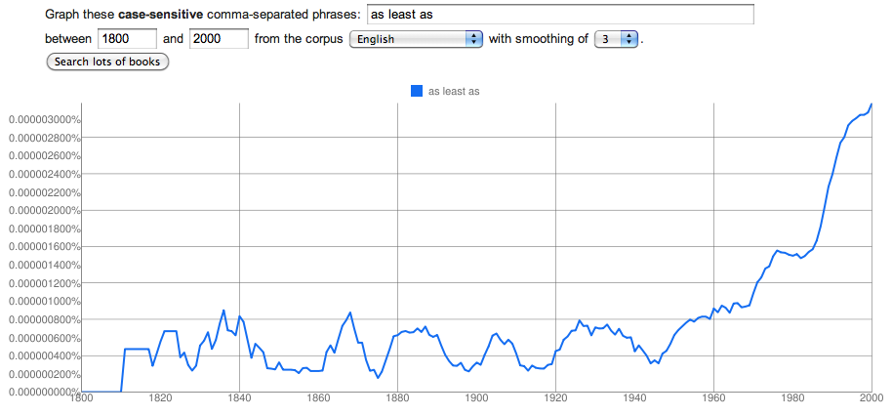
Language change: as least as

Slide 38
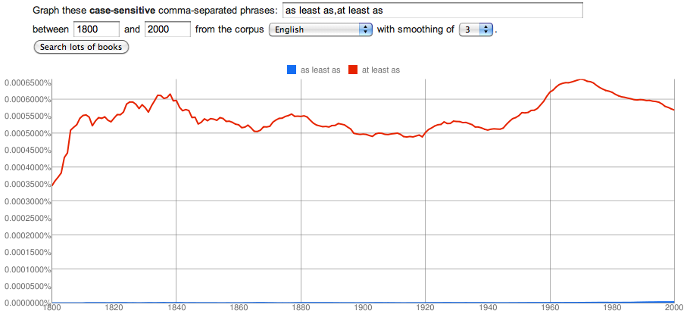
Language change: as least as

Slide 39
4. Collocations, etc.

Slide 40
Using a text editor
You can get a fair distance with a text editor that allows multi-file searches, regular expressions, etc.
It’s like a little concordancer that’s good for close reading
jEdit http://www.jedit.org/
BBedit on Windows
Notes:
Try blood
Do \bblood\b to get only basic blood word.

Slide 41
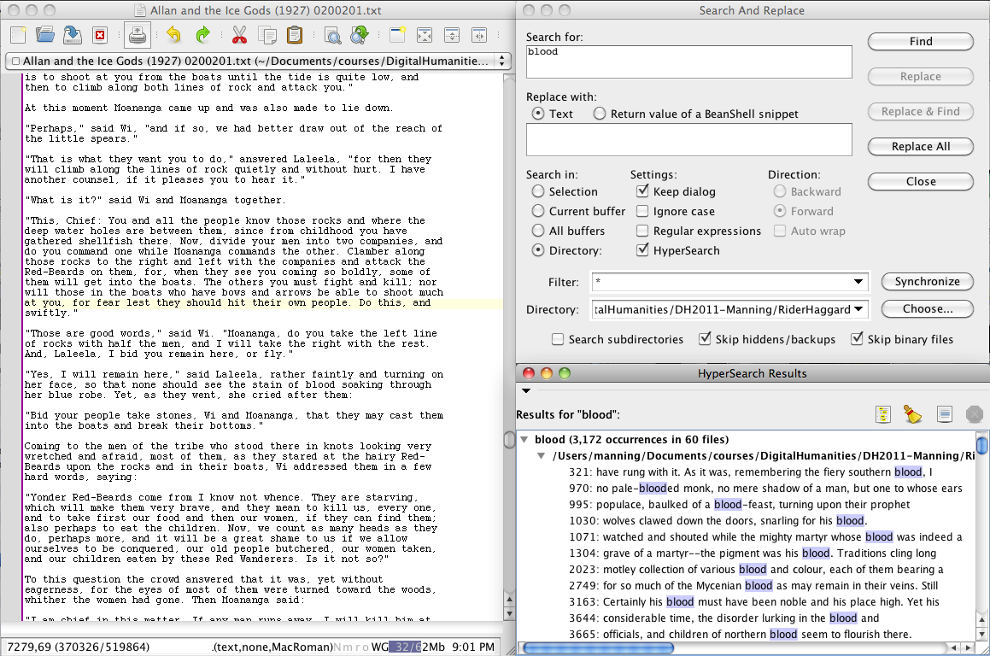

Slide 42
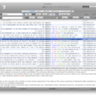
Traditional Concordancers
WordSmith Tools Commercial; Windows
http://www.lexically.net/wordsmith/
Concordance Commercial; Windows
http://www.concordancesoftware.co.uk/
AntConc Free; Windows, Mac OS X (only under X11); Linux
http://www.antlab.sci.waseda.ac.jp/antconc_index.html
CasualConc Free; Mac OS X
http://sites.google.com/site/casualconc/
by Yasu Imao

Slide 43
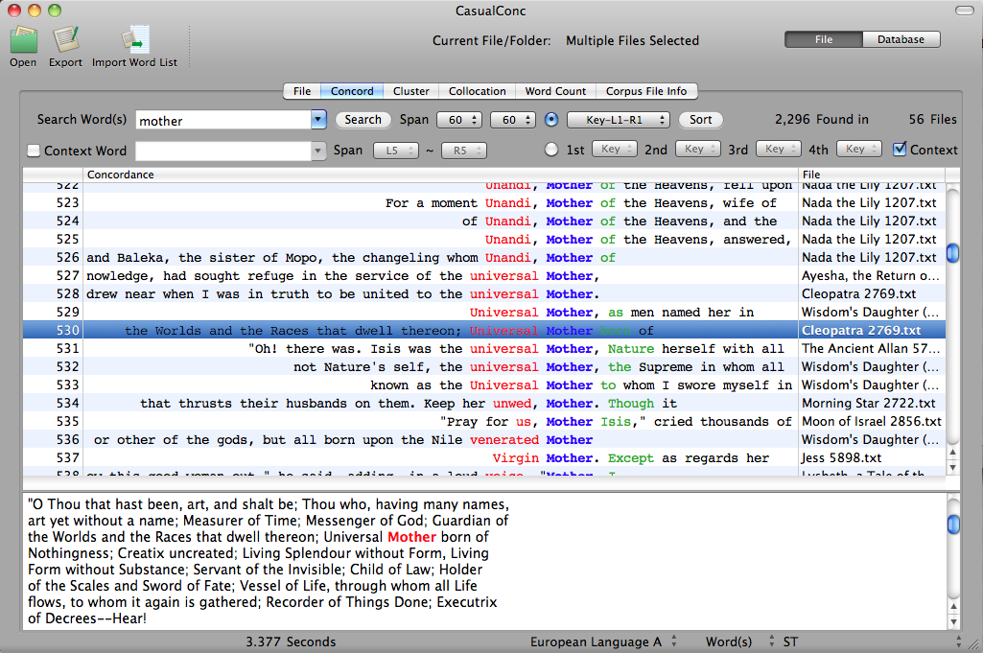

Slide 44
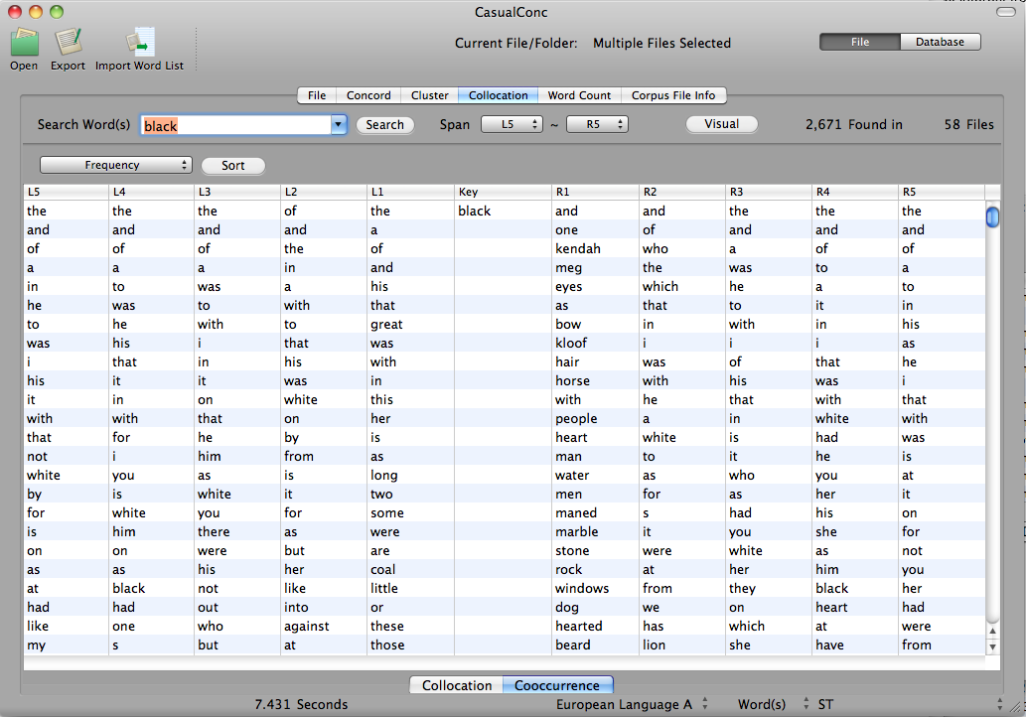

Slide 45
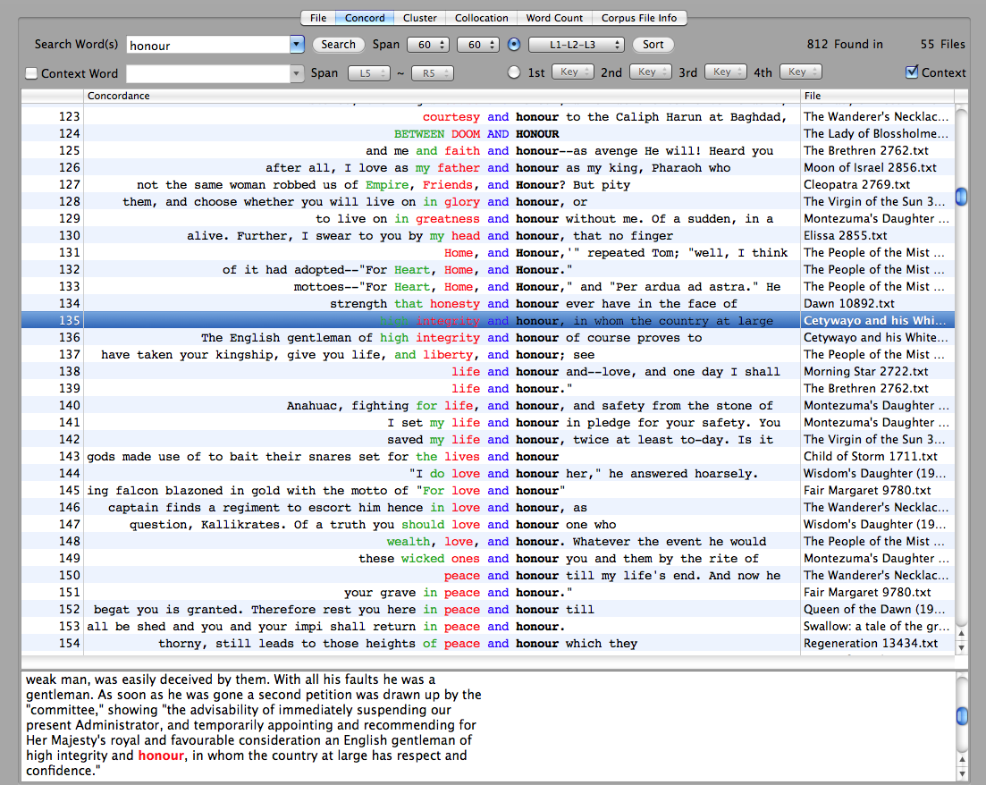

Slide 46
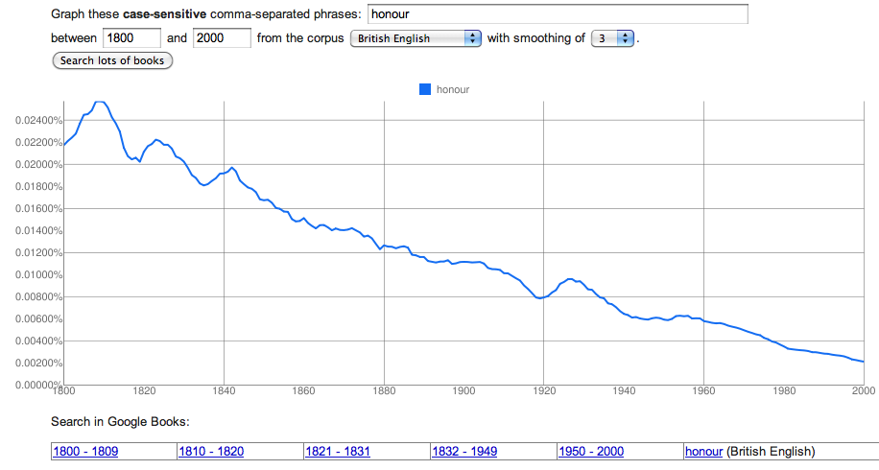
The decline of honour

Slide 47
5. NLP Frameworks and Tools

Slide 48
The Big 3 NLP Frameworks
GATE – General Architecture for Text Engineering (U. Sheffield)
http://gate.ac.uk/
Java, quite well maintained (now)
Includes tons of components
UIMA – Unstructured Information Management Architecture. Originally IBM; now Apache project
http://uima.apache.org/
Professional, scalable, etc.
But, unless you’re comfortable with Xml, Eclipse, Java or C++, etc., I think it’s a non-starter
NLTK – Natural Language To0lkit (started by Steven Bird)
http://www.nltk.org/
Big community; large Python package; corpora and books about it
But it’s code modules and API, no GUI or command-line tools
Like R for NLP. But, hey, R’s becoming very successful….

Slide 49
The main NLP Packages
NLTK Python
http://www.nltk.org/
OpenNLP
http://incubator.apache.org/opennlp/
Stanford NLP
http://nlp.stanford.edu/software/
LingPipe
http://alias-i.com/lingpipe/
More one-off packages than I can fit on this slide
http://nlp.stanford.edu/links/statnlp.html

Slide 50
NLP tools: Rules of thumb for 2011
Unless you’re unlucky, the tool you want to use will work with Unicode (at least BMP), so most any characters are okay
Unless you’re lucky, the tool you want to use will work only on completely plain text, or extremely simple XML-style mark-up (e.g., <s> … </s> around sentences, recognized by regexp)
By default, you should assume that any tool for English was trained on American newswire

Slide 51
GATE

Slide 52
Rule-based NLP and Statistical/Machine Learning NLP
Most work on NLP in the 1960s, 70s and 80s was with hand-built grammars and morphological analyzers (finite state transducers), etc.
ANNIE in GATE is still in this space
Most academic research work in NLP in the 1990s and 2000s use probabilistic or more generally machine learning methods (“Statistical NLP”)
The Stanford NLP tools and MorphAdorner, which we will come to soon, are in this space

Slide 53
Rule-based NLP and Statistical/Machine Learning NLP
Hand-built grammars are fine for tasks in a closed space which do not involve reasoning about contexts
E.g., finding the possible morphological parses of a word
In the old days they worked really badly on “real text”
They were always insufficiently tolerant of the variability of real language
But, built with modern, empirical approaches, they can do reasonably well
ANNIE is an example of this

Slide 54
Rule-based NLP and Statistical/Machine Learning NLP
In Statistical NLP:
You gather corpus data, and usually hand-annotate it with the kind of information you want to provide, such as part-of-speech
You then train (or “learn”) a model that learns to try to predict annotations based on features of words and their contexts via numeric feature weights
You then apply the trained model to new text
This tends to work much better on real text
It more flexibly handles contextual and other evidence
But the technology is still far from perfect, it requires annotated data, and degrades (sometimes very badly) when there are mismatches between the training data and the runtime data

Slide 55
How much hardware do you need?
NLP software often needs plenty of RAM (especially) and processing power
But these days we have really powerful laptops!
Some of the software I show you could run on a machine with 256 MB of RAM (e.g., Stanford Parser), but much of it requires more
Stanford CoreNLP requires a machine with 4GB of RAM
I ran everything in this tutorial on the laptop I’m presenting on … 4GB RAM, 2.8 GHz Core 2 Duo
But it wasn’t always pleasant writing the slides while software was running….

Slide 56
How much hardware do you need?
Why do you need more hardware?
More speed
It took me 95 minutes to run Ayesha, the Return of She through Stanford CoreNLP on my laptop….
More scale
You’d like to be able to analyze 1 million books
Order of magnitude rules of thumb:
POS tagging, NER, etc: 5–10,000 words/second
Parsing: 1–10 sentences per second

Slide 57
How much hardware do you need?
Luckily, most of our problems are trivially parallelizable
Each book/chapter can be run separately, perhaps on a separate machine
What do we actually use?
We do most of our computing on rack mounted Linux servers
Currently 4 x quad core Xeon processors with 24 GB of RAM seem about the sweet spot
About $3500 per machine … not like the old days

Slide 58
6. Part-of-speech Tagging

Slide 59
Part-of-Speech Tagging
Part-of-speech tagging is normally done by a sequence model (acronyms: HMM, CRM, MEMM/CMM)
A POS tag is to be placed above each word
The model considers a local context of possible previous and following POS tags, the current word, neighboring words, and features of them (capitalized?, ends in -ing?)
Each such feature has a weight, and the evidence is combined, and the most likely sequence of tags (according to the model) is chosen
RB
NNP
NNP
RB
VBD
,
JJ
NNS
When
Mr.
Holly
last
wrote
,
many
years

Slide 60
Stanford POS tagger http://nlp.stanford.edu/software/tagger.shtml
$ java -mx1g -cp ../Software/stanford-postagger-full-2011-06-19/stanford-postagger.jar edu.stanford.nlp.tagger.maxent.MaxentTagger -model ../Software/stanford-postagger-full-2011-06-19/models/left3words-distsim-wsj-0-18.tagger -outputFormat tsv -tokenizerOptions untokenizable=allKeep -textFile She\ 3155.txt > She\ 3155.tsv
Loading default properties from trained tagger ../Software/stanford-postagger-full-2011-06-19/models/left3words-distsim-wsj-0-18.tagger
Reading POS tagger model from ../Software/stanford-postagger-full-2011-06-19/models/left3words-distsim-wsj-0-18.tagger ... done [2.2 sec].
Jun 15, 2011 8:17:15 PM edu.stanford.nlp.process.PTBLexer next
WARNING: Untokenizable: ? (U+1FBD, decimal: 8125)
Tagged 132377 words at 5559.72 words per second.
Greek stand-alone Koronis character (a little obscure?)

Slide 61
Stanford POS tagger
For the second time you do it…
$ alias stanfordtag "java -mx1g -cp /Users/manning/Software/stanford-postagger-full-2011-06-19/stanford-postagger.jar edu.stanford.nlp.tagger.maxent.MaxentTagger -model /Users/manning/Software/stanford-postagger-full-2011-06-19/models/left3words-distsim-wsj-0-18.tagger -outputFormat tsv -tokenizerOptions untokenizable=allKeep -textFile"
$ stanfordtag RiderHaggard/King\ Solomon\'s\ Mines\ 2166.txt > tagged/King\ Solomon\'s\ Mines\ 2166.tsv
Reading POS tagger model from /Users/manning/Software/stanford-postagger-full-2011-06-19/models/left3words-distsim-wsj-0-18.tagger ... done [2.1 sec].
Tagged 98178 words at 9807.99 words per second.

Slide 62
MorphAdorner http://morphadorner.northwestern.edu/
MorphAdorner is a set of NLP tools developed at Northwestern by Martin Mueller and colleagues specifically for English language fiction, over a long historical period from EME onwards
lemmatizer, named entity recognizer, POS tagger, spelling standardizer, etc.
Aims to deal with variation in word breaking and spelling over this period
Includes its own POS tag set: NUPOS

Slide 63
MorphAdorner
$ ./adornplaintext temp temp/3155.txt
2011-06-15 20:30:52,111 INFO - MorphAdorner version 1.0
2011-06-15 20:30:52,111 INFO - Initializing, please wait...
2011-06-15 20:30:52,318 INFO - Using Trigram tagger.
2011-06-15 20:30:52,319 INFO - Using I retagger.
2011-06-15 20:30:53,578 INFO - Loaded word lexicon with 151,922 entries in 2 seconds.
2011-06-15 20:30:55,920 INFO - Loaded suffix lexicon with 214,503 entries in 3 seconds.
2011-06-15 20:30:57,927 INFO - Loaded transition matrix in 3 seconds.
2011-06-15 20:30:58,137 INFO - Loaded 162,248 standard spellings in 1 second.
2011-06-15 20:30:58,697 INFO - Loaded 5,434 alternative spellings in 1 second.
2011-06-15 20:30:58,703 INFO - Loaded 349 more alternative spellings in 14 word classes in 1 second.
2011-06-15 20:30:58,713 INFO - Loaded 0 names into name standardizer in < 1 second.
2011-06-15 20:30:58,779 INFO - 1 file to process.
2011-06-15 20:30:58,789 INFO - Before processing input texts: Free memory: 105,741,696, total memory: 480,694,272
2011-06-15 20:30:58,789 INFO - Processing file 'temp/3155.txt' .
2011-06-15 20:30:58,789 INFO - Adorning temp/3155.txt with parts of speech.
2011-06-15 20:30:58,832 INFO - Loaded text from temp/3155.txt in 1 second.
2011-06-15 20:31:01,498 INFO - Extracted 131,875 words in 4,556 sentences in 3 seconds.
2011-06-15 20:31:03,860 INFO - lines: 1,000; words: 27,756
2011-06-15 20:31:04,364 INFO - lines: 2,000; words: 58,728
2011-06-15 20:31:04,676 INFO - lines: 3,000; words: 84,735
2011-06-15 20:31:04,990 INFO - lines: 4,000; words: 115,396
2011-06-15 20:31:05,152 INFO - lines: 4,556; words: 131,875
2011-06-15 20:31:05,152 INFO - Part of speech adornment completed in 4 seconds. 36,100 words adorned per second.
2011-06-15 20:31:05,152 INFO - Generating other adornments.
2011-06-15 20:31:13,840 INFO - Adornments written to temp/3155-005.txt in 9 seconds.
2011-06-15 20:31:13,840 INFO - All files adorned in 16 seconds.

Slide 64
Ah, the old days!
$ ./adornplaintext temp temp/Hunter\ Quartermain.txt
2011-06-15 17:18:15,551 INFO - MorphAdorner version 1.0
2011-06-15 17:18:15,552 INFO - Initializing, please wait...
2011-06-15 17:18:15,730 INFO - Using Trigram tagger.
2011-06-15 17:18:15,731 INFO - Using I retagger.
2011-06-15 17:18:16,972 INFO - Loaded word lexicon with 151,922 entries in 2 seconds.
2011-06-15 17:18:18,684 INFO - Loaded suffix lexicon with 214,503 entries in 2 seconds.
2011-06-15 17:18:20,662 INFO - Loaded transition matrix in 2 seconds.
2011-06-15 17:18:20,887 INFO - Loaded 162,248 standard spellings in 1 second.
2011-06-15 17:18:21,300 INFO - Loaded 5,434 alternative spellings in 1 second.
2011-06-15 17:18:21,303 INFO - Loaded 349 more alternative spellings in 14 word classes in 1 second.
2011-06-15 17:18:21,312 INFO - Loaded 0 names into name standardizer in 1 second.
2011-06-15 17:18:21,381 INFO - No files found to process.
But it works better if you make sure the filename has no spaces in it ☺

Slide 65
Comparing taggers: Penn Treebank vs. NUPOS
Holly NNP Holly n1
, , , ,
if IN if cs
you PRP you pn22
will MD will vmb
accept VB accept vvi
the DT the dt
trust NN trust n1
, , , ,
I PRP I pns11
am VBP am vbm
going VBG going vvg
to TO to pc-acp
leave VB leave vvi
you PRP you pn22
that IN that d
boy NN boy's ng1
's POS
sole JJ sole j
guardian NN guardian n1
. . . .

Slide 66
Comparing taggers: Penn Treebank vs. NUPOS
Holly NNP Holly n1
, , , ,
if IN if cs
you PRP you pn22
will MD will vmb
accept VB accept vvi
the DT the dt
trust NN trust n1
, , , ,
I PRP I pns11
am VBP am vbm
going VBG going vvg
to TO to pc-acp
leave VB leave vvi
you PRP you pn22
that IN that d
boy NN boy's ng1
's POS
sole JJ sole j
guardian NN guardian n1
. . . .

Slide 67
Stylistic factors from POS

Slide 68
7. Named Entity Recognition (NER)

Slide 69
Named Entity Recognition – “the Chad problem”
Germany’s representative to the European Union’s veterinary committee Werner Zwingman said on Wednesday consumers should …
IL-2 gene expression and NF-kappa B activation through CD28 requires reactive oxygen production by 5-lipoxygenase.

Slide 70
Conditional Random Fields (CRFs)
O
PER
PER
O
O
O
O
O
When
Mr.
Holly
last
wrote
,
many
years
We again use a sequence model – different problem, but same technology
Indeed, sequence models are used for lots of tasks that can be construed as labeling tasks that require only local context (to do quite well)
There is a background label – O – and labels for each class
Entities are both segmented and categorized
Notes:
Like a discriminatively trained HMM, but not locally normalized - removes label bias
Features are over cliques - local features and edge features
Canbe higher order # labels ^ N

Slide 71
Stanford NER Features
Word features: current word, previous word, next word, a word is anywhere in a +/– 4 word window
Orthographic features:
Jenny → Xxxx
IL-2 → XX-#
Prefixes and Suffixes:
Jenny → <J, <Je, <Jen, …, nny>, ny>, y>
Label sequences
Lots of feature conjunctions
Notes:
POS tags not so helpful (not bad, but not worth the effort)
Also havent gotten much value from gazeteers
Bio had lots of specialized features

Slide 72
Stanford NER http://nlp.stanford.edu/software/CRF-NER.shtml
$ java -mx500m -Dfile.encoding=utf-8 -cp Software/stanford-ner-2011-06-19/stanford-ner.jar edu.stanford.nlp.ie.crf.CRFClassifier -loadClassifier Software/stanford-ner-2011-06-19/classifiers/all.3class.distsim.crf.ser.gz -textFile RiderHaggard/She\ 3155.txt > ner/She\ 3155.ner
For thou shalt rule this <LOCATION>England</LOCATION>----”
"But we have a queen already," broke in <LOCATION>Leo</LOCATION>, hastily.
"It is naught, it is naught," said <PERSON>Ayesha</PERSON>; "she can be overthrown.”
At this we both broke out into an exclamation of dismay, and explained that we should as soon think of overthrowing ourselves.
"But here is a strange thing," said <PERSON>Ayesha</PERSON>, in astonishment; "a queen whom her people love! Surely the world must have changed since I dwelt in <LOCATION>Kôr</LOCATION>."
Notes:
POS tags not so helpful (not bad, but not worth the effort)
Also havent gotten much value from gazeteers
Bio had lots of specialized features

Slide 73
8. Parsing

Slide 74
Statistical parsing
One of the big successes of 1990s statistical NLP was the development of statistical parsers
These are trained from hand-parsed sentences (“treebanks”), and know statistics about phrase structure and word relationships, and use them to assign the most likely structure to a new sentence
They will return a sentence parse for any sequence of words. And it will usually be mostly right
There are many opportunities for exploiting this richer level of analysis, which have only been partly realized.

Slide 75
Phrase structure Parsing
Phrase structure representations have dominated American linguistics since the 1930s
They focus on showing words that go together to form natural groups (constituents) that behave alike
They are good for showing and querying details of sentence structure and embedding
S
NP
VP
VBD
VP
NP
PP
VBN
PP
IN
NP
IN
NP
NNS
NNS
CC
NN
NNP
NNP
Bills on ports and immigration were submitted by Senator Brownback

Slide 76
Dependency parsing
A dependency parse shows which words in a sentence modify other words
The key notion are governors with dependents
Widespread use: Pāṇini, early Arabic grammarians, diagramming sentences, …
submitted
nsubjpass
auxpass
prep
Bills
were
by
prep
pobj
on
Brownback
pobj
nn
appos
ports
Senator
Republican
cc
conj
prep
and
immigration
of
pobj
Kansas

Slide 77
Stanford Dependencies
SD is a particular dependency representation designed for easy extraction of meaning relationships [de Marneffe & Manning, 2008]
It’s basic form in the last slide has each word as is
A “collapsed” form focuses on relations between main words
submitted
nsubjpass
auxpass
Bills
were
agent
prep_on
Brownback
nn
appos
ports
Senator
Republican
conj_and
prep_on
prep_of
immigration
Kansas

Slide 78
Statistical Parsers
There are now many good statistical parsers that are freely downloadable
Constituency parsers
Collins/Bikel Parser
Berkeley Parser
BLLIP Parser = Charniak/Johnson Parser
Dependency parsers
MaltParser
MST Parser
But I’ll show the Stanford Parser ☺

Slide 79
Tregex/Tgrep2 – Tools for searching over syntax
Notes:
SINV – works well. First 2 or 3 examples
NP < /^PRP\$$/ < CC
NP < (NP < /^JJ/) < SBAR

Slide 80
dreadful things
She
Ayesha
amod(day-18, dreadful-17)
amod(day-45, dreadful-44)
amod(feast-33, dreadful-32)
amod(fits-51, dreadful-50)
amod(form-59, dreadful-58)
amod(laugh-9, dreadful-8)
amod(manifestation-9, dreadful-8)
amod(manner-29, dreadful-28)
amod(marshes-17, dreadful-16)
amod(people-12, dreadful-11)
amod(people-46, dreadful-45)
amod(place-16, dreadful-15)
amod(place-6, dreadful-5)
amod(sight-5, dreadful-4)
amod(spot-13, dreadful-12)
amod(thing-41, dreadful-40)
amod(thing-5, dreadful-4)
amod(tragedy-22, dreadful-21)
amod(wilderness-43, dreadful-42)
amod(clouds-5, dreadful-2)
amod(debt-26, dreadful-25)
amod(doom-21, dreadful-20)
amod(fashion-50, dreadful-47)
amod(form-10, dreadful-7)
amod(oath-42, dreadful-41)
amod(road-23, dreadful-22)
amod(silence-5, dreadful-4)
amod(threat-19, dreadful-18)

Slide 81
Making use of dependency structure
J. Engelberg Costly Information Processing (AFA, 2009):
An efficient market should immediately incorporate all publicly available information.
But many studies have shown there is a lag
And the lag is greater on Fridays (!)
An explanation for this is that there is a cost to information processing
Engelberg tests and shows that “soft” (textual) information takes longer to be absorbed than “hard” (numeric) information … it’s higher cost information processing
But “soft” information has value beyond “hard” information
It’s especially valuable for predicting further out in time
Notes:
Work done at Kellogg business school at Northwestern; now has a job at University of North Carolina, Chapel Hill
AFA meeting is American Finance Association meeting with 2009 Annual Meeting in San Francisco

Slide 82
Evidence from earnings announcements [Engelberg AFA 2009]
But how do you use the “soft” information?
Simply using proportion of “negative” words (from the Harvard General Inquirer lexicon) is a useful predictive feature of future stock behavior
Although sales remained steady, the firm continues to suffer from rising oil prices.
“But this [or text categorization] is not enough. In order to refine my analysis, I need to know that the negative sentiment is about oil prices.”
He thus turns to use of the typed dependencies representation of the Stanford Parser.
Words that negative words relate to are grouped into 1 of 6 categories [5 word lists or “other”]

Slide 83
Evidence from earnings announcements [Engelberg 2009]
In a regression model with many standard quantitative predictors…
Just the negative word fraction is a significant predictor of 3 day or 80 day post earnings announcement abnormal returns (CAR)
Coefficient −0.173, p < 0.05 for 80 day CAR
Negative sentiment about different things has differential effects
Fundamentals: −0.198, p < 0.01 for 80 day CAR
Future: −0.356, p < 0.05 for 80 day CAR
Other: −0.023, p < 0.01 for 80 day CAR
Only some of which analysts pay attention to
Analyst forecast-for-quarter-ahead earnings is predicted by negative sentiment on Environment and Other but not Fundamentals or Future!
Notes:
Positive Fundamentals = Fundamentals; Negative Fundamentals; Future; Environment; Operations; Other

Slide 84
Syntactic Packaging and Implicit Sentiment [Greene 2007; Greene and Resnik 2009]
Positive or negative sentiment can be carried by words (e.g., adjectives), but often it isn’t….
These sentences differ in sentiment, even though the words aren’t so different:
A soldier veered his jeep into a crowded market and killed three civilians
A soldier’s jeep veered into a crowded market and three civilians were killed
As a measurable version of such issues of linguistic perspective, they define OPUS features
For domain relevant terms, OPUS features pair the word with a syntactic Stanford Dependency:
killed:DOBJ NSUBJ:soldier killed:NSUBJ
Notes:
Domain relevant terms = [using relative frequency ratio against general text]

Slide 85
Predicting Opinions of the Death Penalty [Greene 2007; Greene and Resnik 2009]
Collected pro- and anti- death penalty texts from websites with manual checking
Training is cross-validation of training on some pro- and anti- sites and testing on documents from others [can’t use site-specific nuances]
Baseline is word and word bigram features in a support vector machine [SVM = good classifier]
58% error reduction!
Condition | SVM accuracy
Baseline | 72.0%
With OPUS features | 88.1%

Slide 86
9. Coreference Resolution

Slide 87
Coreference resolution
The goal is to work out which (noun) phrases refer to the same entities in the world
Sarah asked her father to look at her. He appreciated that his eldest daughter wanted to speak frankly.
≈ anaphora resolution ≈ pronoun resolution ≈ entity resolution

Slide 88
Coreference resolution warnings
Warning: The tools we have looked at so far work one sentence at a time – or use the whole document but ignore all structure and just count – but coreference uses the whole document
The resources used will grow with the document size – you might want to try a chapter not a novel
Coreference systems normally require processing with parsers, NER, etc. first, and use of lexicons

Slide 89
Coreference resolution warnings
English-only for the moment….
While there are some papers on coreference resolution in other languages, I am aware of no downloadable coreference systems for any language other than English
For English, there are a good number of downloadable systems, but their performance remains modest. It’s just not like POS tagging, NER or parsing

Slide 90
Coreference resolution warnings
Nevertheless, it’s not yet known to the State of California to cause cancer, so let’s continue….

Slide 91
Stanford CoreNLP http://nlp.stanford.edu/software/corenlp.shtml
Stanford CoreNLP is our new package that ties together a bunch of NLP tools
POS tagging
Named Entity Recognition
Parsing
and Coreference Resolution
Output is an XML representation [only choice at present]
Contains a state-of-the-art coreference system!

Slide 92
Stanford CoreNLP
$ java -mx3g -Dfile.encoding=utf-8 -cp "Software/stanford-corenlp-2011-06-08/stanford-corenlp-2011-06-08.jar:Software/stanford-corenlp-2011-06-08/stanford-corenlp-models-2011-06-08.jar:Software/stanford-corenlp-2011-06-08/xom.jar:Software/stanford-corenlp-2011-06-08/jgrapht.jar" edu.stanford.nlp.pipeline.StanfordCoreNLP -file RiderHaggard/Hunter\ Quatermain\'s\ Story\ 2728.txt -outputDirectory corenlp

Slide 93
What Stanford CoreNLP gives
Sarah asked her father to look at her .
He appreciated that his eldest daughter wanted to speak frankly .
Coreference resolution graph
sentence 1, headword 1 (gov)
sentence 1, headword 3
sentence 1, headword 4 (gov)
sentence 2, headword 1
sentence 2, headword 4

Slide 94
What Stanford CoreNLP gives
Sarah asked her father to look at her .
He appreciated that his eldest daughter wanted to speak frankly .
Coreference resolution graph
sentence 1, headword 1 (gov)
sentence 1, headword 3
sentence 1, headword 4 (gov)
sentence 2, headword 1
sentence 2, headword 4

Slide 95
The rest of the languages of the world

Slide 96
English-only?
There are a lot of languages out there in the world!
But there are a lot more NLP tools for English than anything else
However, there is starting to be fairly reasonable support (or the ability to build it) for most of the top 50 or so languages…
I’ll say a little about that, since some people are definitely interested, even if I’ve covered mainly English

Slide 97
POS taggers for many languages?
Two choices:
Find a tagger with an existing model for the language (and period) of interest
Find POS-tagged training data for the language (and period) of interest and train your own tagger
Most downloadable taggers allow you to train new models – e.g., the Stanford POS tagger
But it may involve considerable data preparation work and understanding and not be for the faint-hearted

Slide 98
POS taggers for many languages?
One tagger with good existing multi-lingual support
TreeTagger (Helmut Schmid)
http://www.ims.uni-stuttgart.de/projekte/corplex/TreeTagger/
Bulgarian, Chinese, Dutch, English, Estonian, French, Old French, Galician, German, Greek, Italian, Latin, Portuguese, Russian, Spanish, Swahili
Free for non-commercial, not open source; Linux, Mac, Sparc (not Windows)
Stanford POS Tagger presently comes with:
English, Arabic, Chinese, German
One place to look for more resources:
http://nlp.stanford.edu/links/statnlp.html
But it’s always out of date, so also try a Google search ☺

Slide 99
Chinese example
Chinese doesn’t put spaces between words
Nor did Ancient Greek
So almost all tools first require word segmentation
I demonstrate the Stanford Chinese Word Segmenter
http://nlp.stanford.edu/software/segmenter.shtml
Even in English, words need some segmentation – often called tokenization
It was being implicitly done before further processing in the examples till now: “I’ll go.” → “ I ’ll go . ”

Slide 100
Chinese example
$ ../Software/stanford-chinese-segmenter-2010-03-08/segment.sh ctb Xinhua.txt utf-8 0 > Xinhua.seg
$ java -mx300m -cp ../Software/stanford-postagger-full-2011-05-18/stanford-postagger.jar edu.stanford.nlp.tagger.maxent.MaxentTagger -model ../Software/stanford-postagger-full-2011-05-18/models/chinese.tagger -textFile Xinhua.seg > Xinhua.tag

Slide 101
Chinese example
# space before 。 below!
$ perl -pe 'if ( ! m/^\s*$/ && ! m/^.{100}/) { s/$/ 。/; }' < Xinhua.seg > Xinhua.seg.fixed
$ java -mx600m -cp ../Software/stanford-parser-2011-06-15/stford-parser.jar edu.stanford.nlp.parser.lexparser.LexicalizedParser -encoding utf-8 ../Software/stanford-parser-2011-04-17/chineseFactored.ser.gz Xinhua.seg.fixed > Xinhua.parsed
$ java -mx1g -cp ../Software/stanford-parser-2011-06-15/stanford-parser.jar edu.stanford.nlp.parser.lexparser.LexicalizedParser -encoding utf-8 -outputFormat typedDependencies ../Software/stanford-parser-2011-04-17/chineseFactored.ser.gz Xinhua.seg.fixed > Xinhua.sd

Slide 102
Other tools
Dependency parsers are now available for many languages, especially via MaltParser:
http://maltparser.org/
For instance, it’s used to provide a Russian parser among the resources here:
http://corpus.leeds.ac.uk/mocky/
The OPUS (Open Parallel Corpus) collects tools for various languages:
http://opus.lingfil.uu.se/trac/wiki/Tagging%20and%20Parsing
Look around!

Slide 103
Data sources
Parsers depend on annotated data (treebanks)
You can use a parser trained on news articles, but better resources for humanities scholars will depend on community efforts to produce better data
One effort is the construction of Greek and Latin dependency treebanks by the Perseus ProjectI:
http://nlp.perseus.tufts.edu/syntax/treebank/

Slide 104
Parting words

Slide 105
Applications? (beyond word counts)
There are starting to be a few applications in the humanities using richer NLP methods:
But only a few….

Slide 106
Applications? (beyond word counts)
Cameron Blevins. 2011. Topic Modeling Historical Sources: Analyzing the Diary of Martha Ballard. DH 2011.
Uses (latent variable) topic models (LDA and friends)
Topic model are primarily used to find themes or topics running through a group of texts
But, here, also helpful for dealing with spelling variation (!)
Uses MALLET (http://mallet.cs.umass.edu/), a toolkit with a fair amount of stuff for text classification, sequence tagging and topic models
We also have the Stanford Topic Modeling Toolbox
http://nlp.stanford.edu/software/tmt/tmt-0.3/
Examines change in diary entry topics over time

Slide 107
Applications? (beyond word counts)
David K. Elson, Nicholas Dames, Kathleen R. McKeown. 2010. Extracting Social Networks from Literary Fiction. ACL 2010.
How size of community in novel or world relates to amount of conversation
(Stanford) NER tagger to identify people and organizations
Heuristically matching to name variants/shortenings
System for speech attribution (Elson & McKeown 2010)
Social network construction
Results showing that urban novel social networks are not richer than those in rural settings, etc.

Slide 108
Applications? (beyond word counts)
Aditi Muralidharan. 2011. A Visual Interface for Exploring Language Use in Slave Narratives DH 2011. http://bebop.berkeley.edu/wordseer
A visualization and reading interface to American Slae Narratives
(Stanford) Parser used to allow searching of particular grammatical relationships: grammatical search
Visualization tools to show a word’s distribution in text and to provide a “collapsed concordance” view – and for close reading
Example application is exploring relationship with God

Slide 109
Parting words
This talk has been about tools –
they’re what I know
But you should focus on disciplinary insight –
not on building corpora and tools, but on using
them as tools for producing disciplinary research

